Slide 1
Supporting the Best of Both Worlds:
Healthy crops AND healthy honey bees
TPSA Conference, Bee Health Session 2, 06 February 2014
Dick Rogers, M.Sc.
Entomologist / Manager, Bayer Bee Care Center – NA dick.rogers@bayer.com

Slide 2
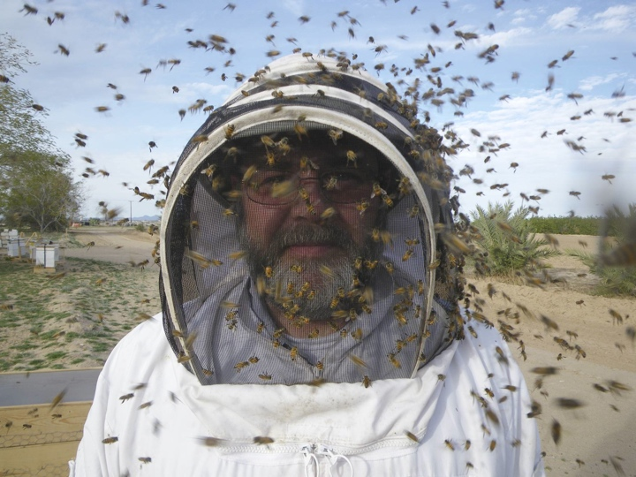
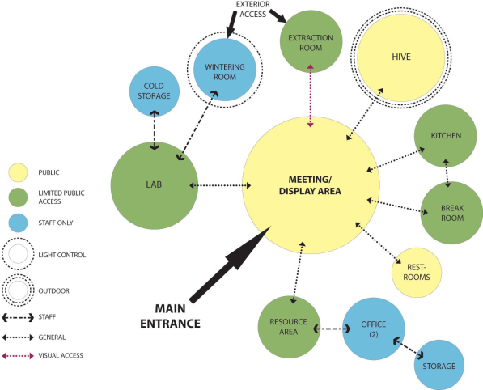
Bee Care Center Functionality
Site Placement
Existing structure
New construction
Functionality
Access / Security
Research
Meeting & training
Communication
Bayer brand
Feet on the ground
Collaborative

Slide 3
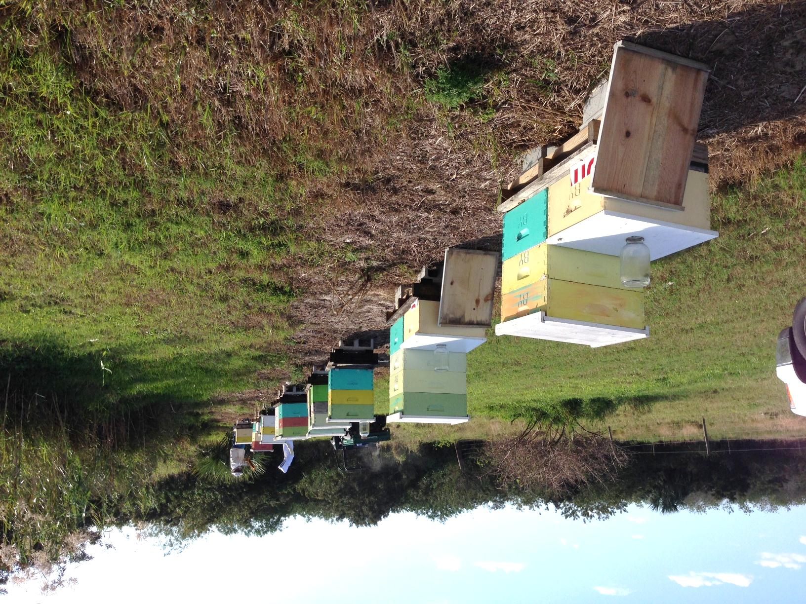
North America – A continent of extremes…

Slide 4
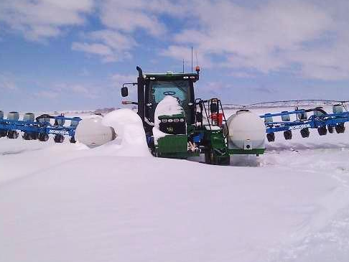
…no single recommendation for crops or honey bees.
To support the best of both worlds, i.e. healthy bees and healthy crops, we need to understand and appreciate the issues, and encourage “idea flow*” and engagement.
* Passing of ideas between people and groups. –Alex Pentland, MIT

Slide 5
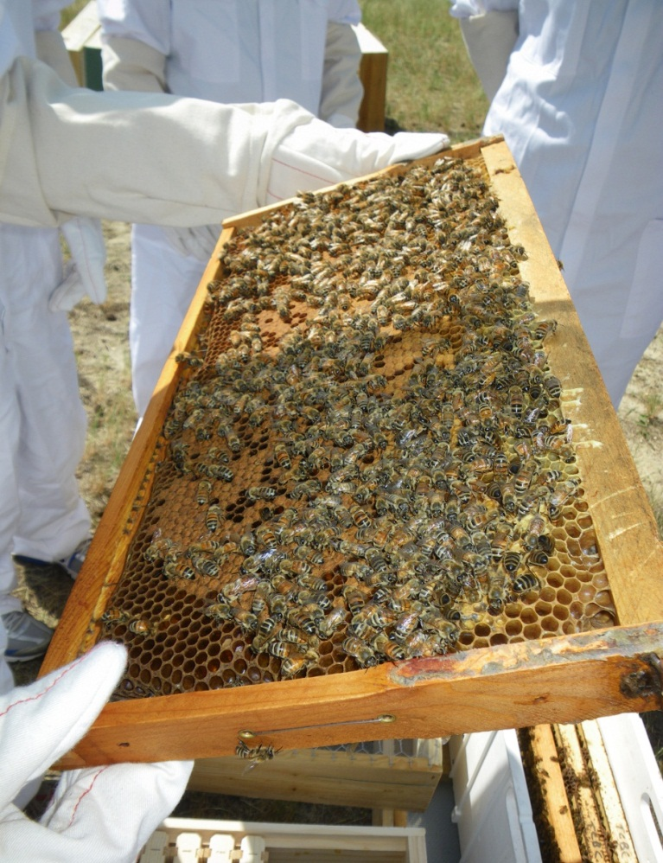
Outline
Importance of honey bees
Challenges for bees and crops
The underlying causes
Apiculture in transition
Solution overview
Working toward positive impact
Bayer Bee Care Program
Wrap up
Image here

Slide 6

Importance of Honey Bees

Slide 7
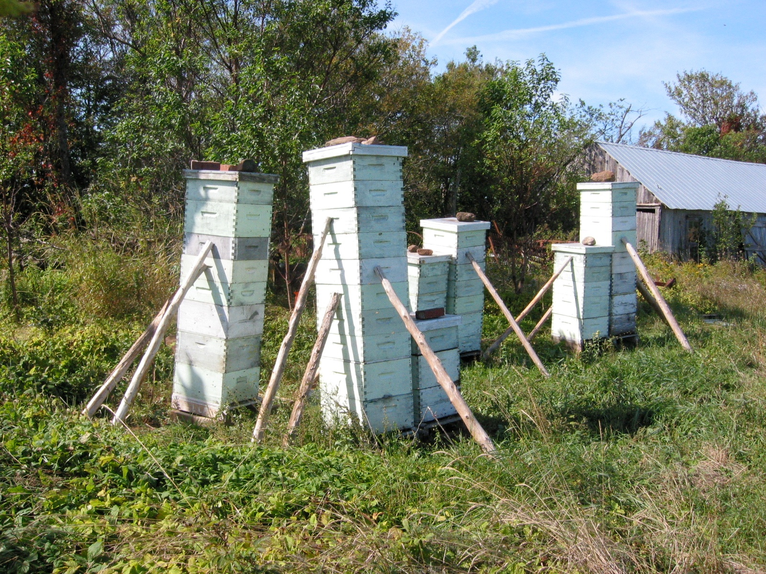

Slide 8
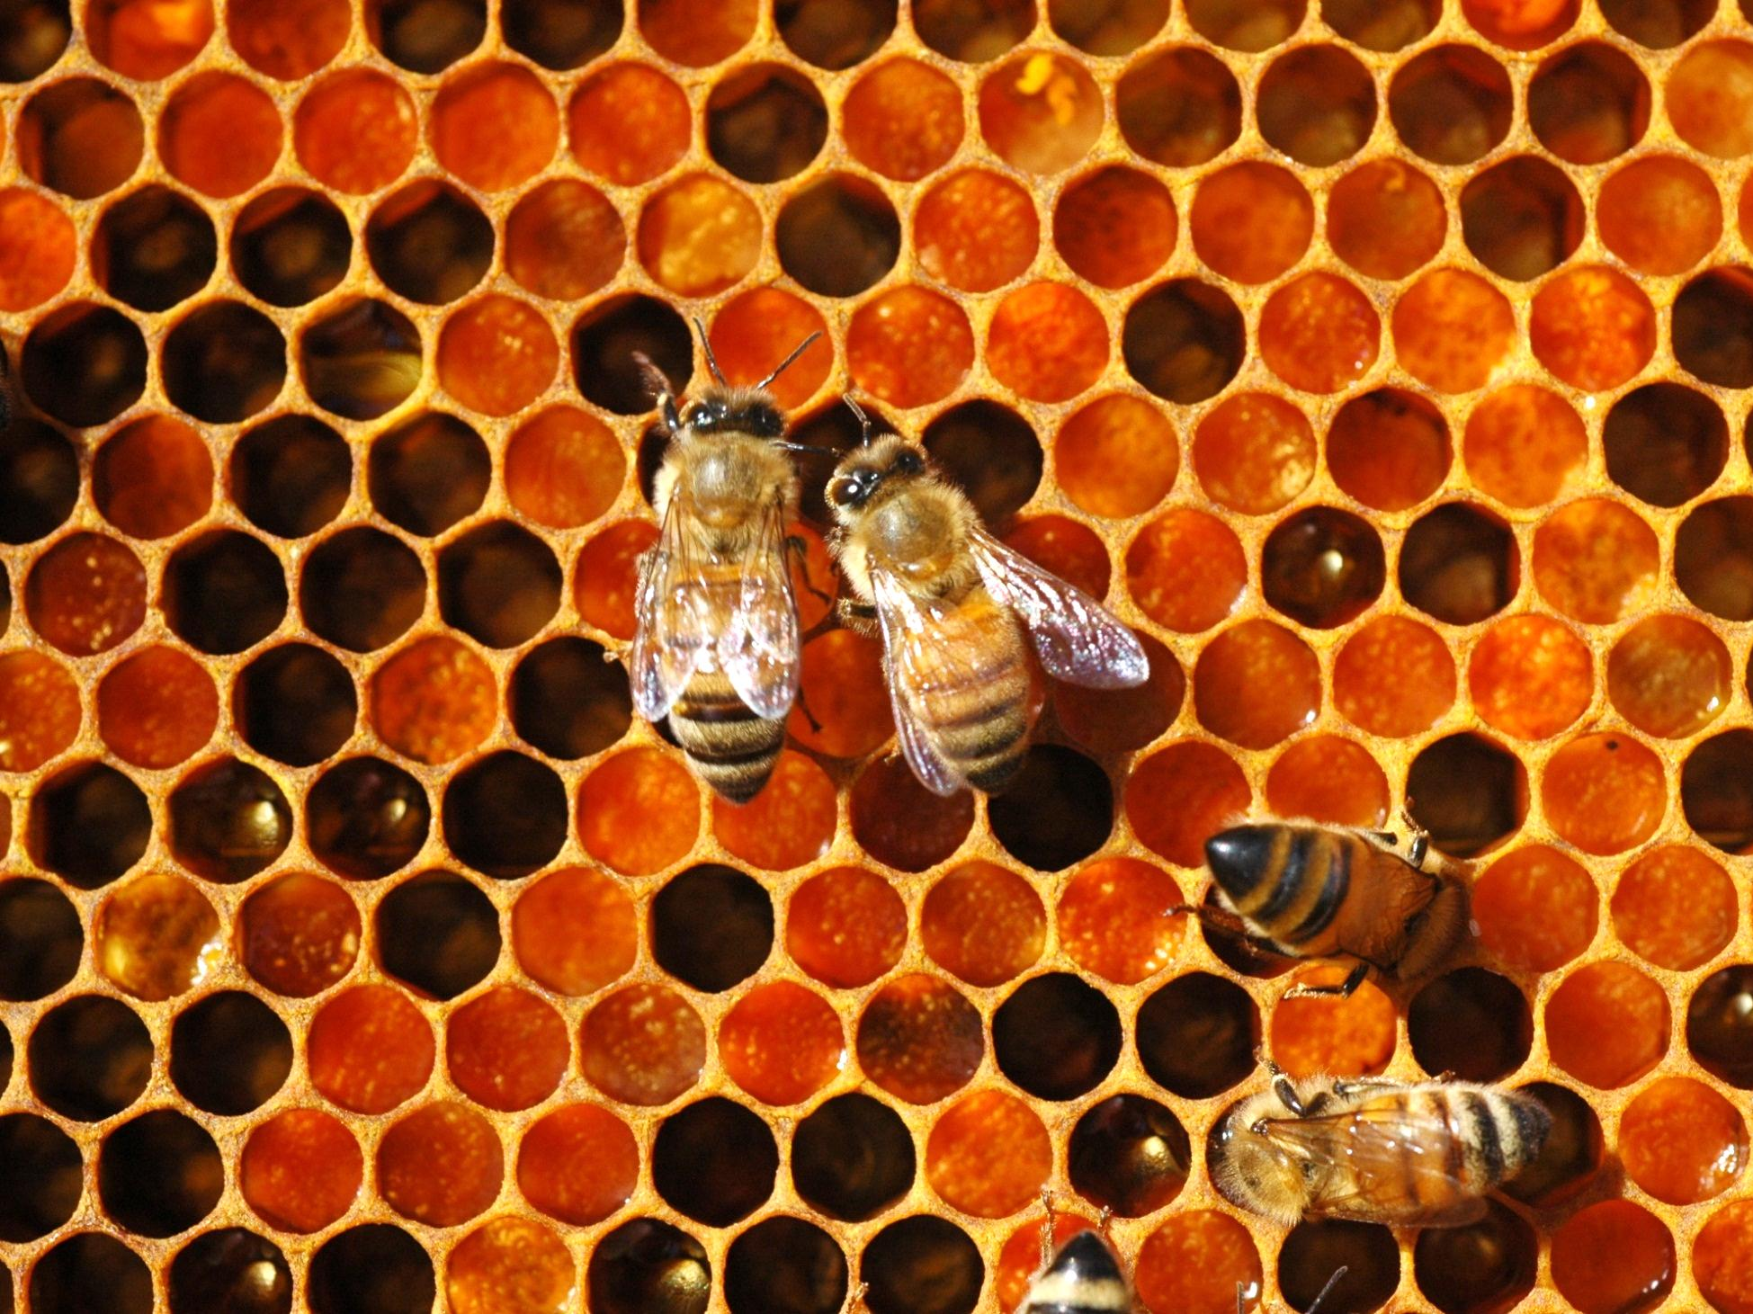

Slide 9
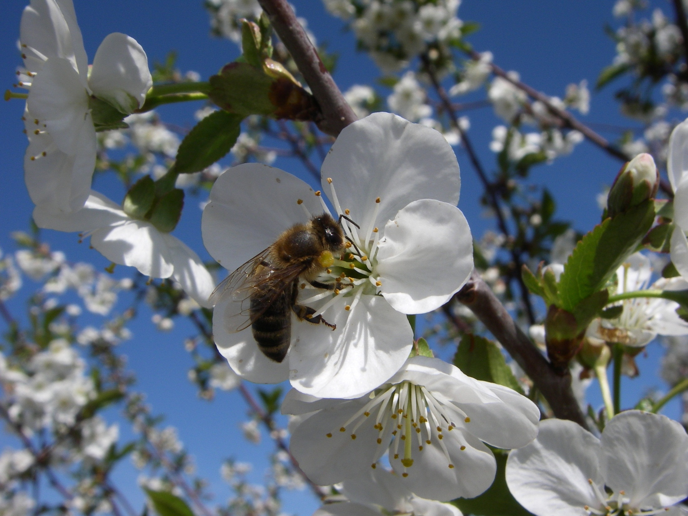

Slide 10
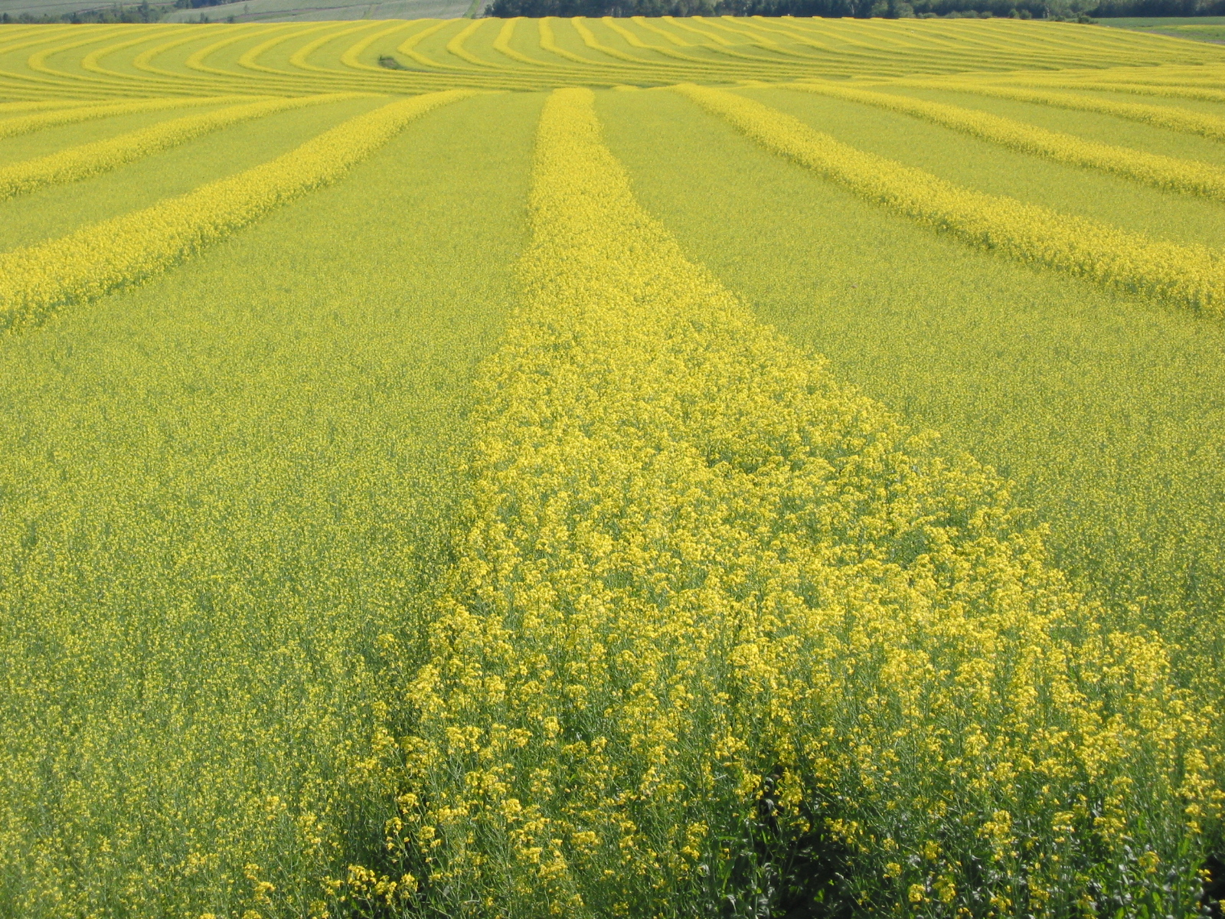

Slide 11
Definition of Pollination
Pollination is the transfer of pollen from male part to female part of flower
********
The sparkplug that starts the crop production engine

Slide 12
Challenges for Honey Bees and Crops

Slide 13
What Honey Bees Need to Survive
VENTILATION
SPACE
SHELTER
WARM
WATER
DRY
FOOD
PROTEIN
CARBOHYDRATE
VANDALISM
TOXINS
SAFETY
All of these elements are required for a colony to survive and prosper
PREDATORS
PARASITES
DISEASES
Notes:
In nature, these elements would limit the abundance and distribution of colonies; under management, beekeepers need to ensure all these elements are provided, either naturally or supplementary

Slide 14
Is there a honey bee health problem?
15-20%
2012/2013 US Forecast
Based on numerous criteria as early as August 2012, the Bayer Bee Care Center forecast for colony losses from fall 2012 through spring 2013 was 50-60%+.
2013/2014 US Forecast
More difficult to forecast
50-60%

Slide 15
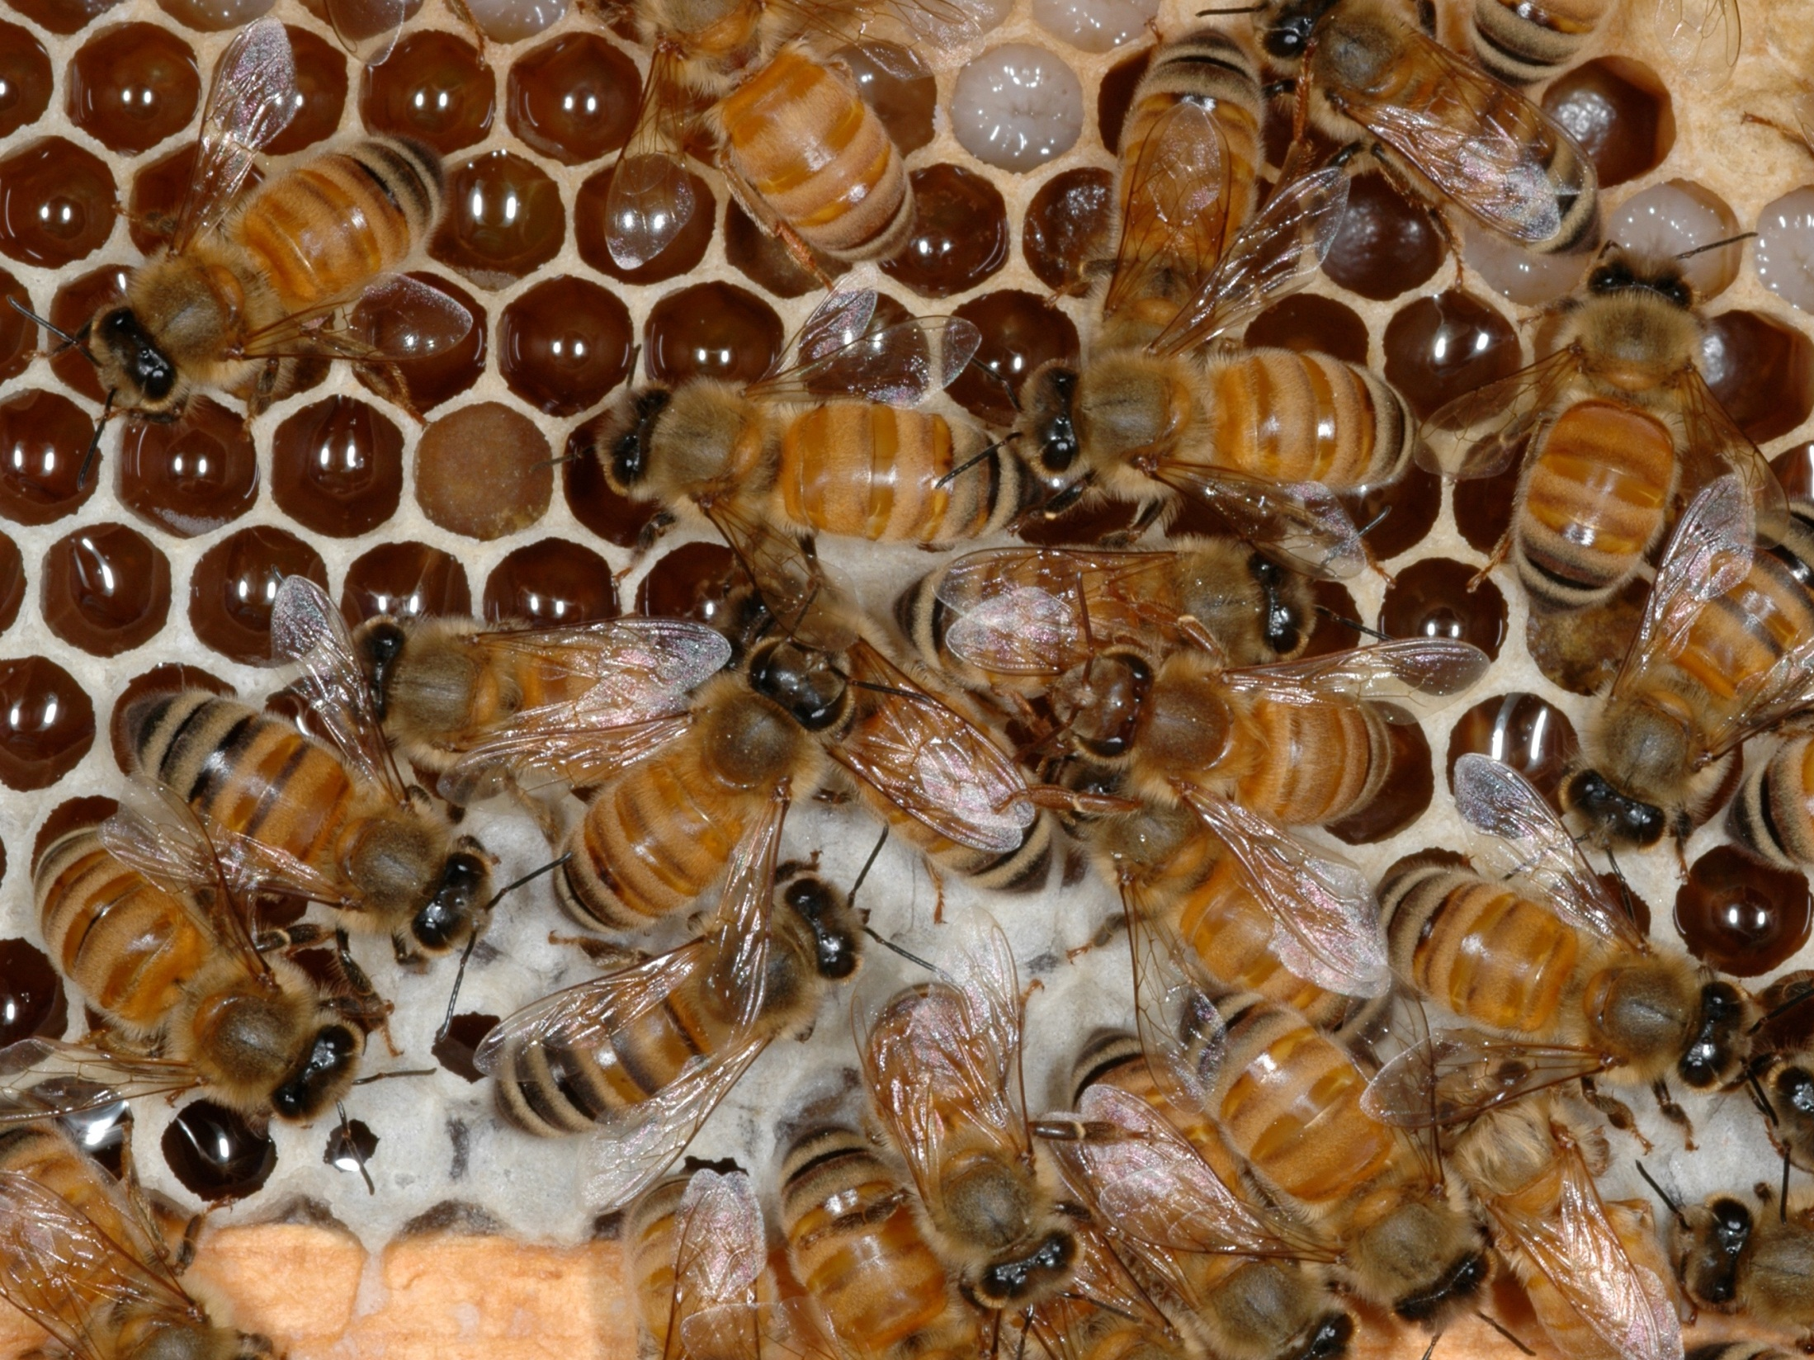
Honey bee health needs to be protected for production of hive products, bee stock, and pollination services

Slide 16
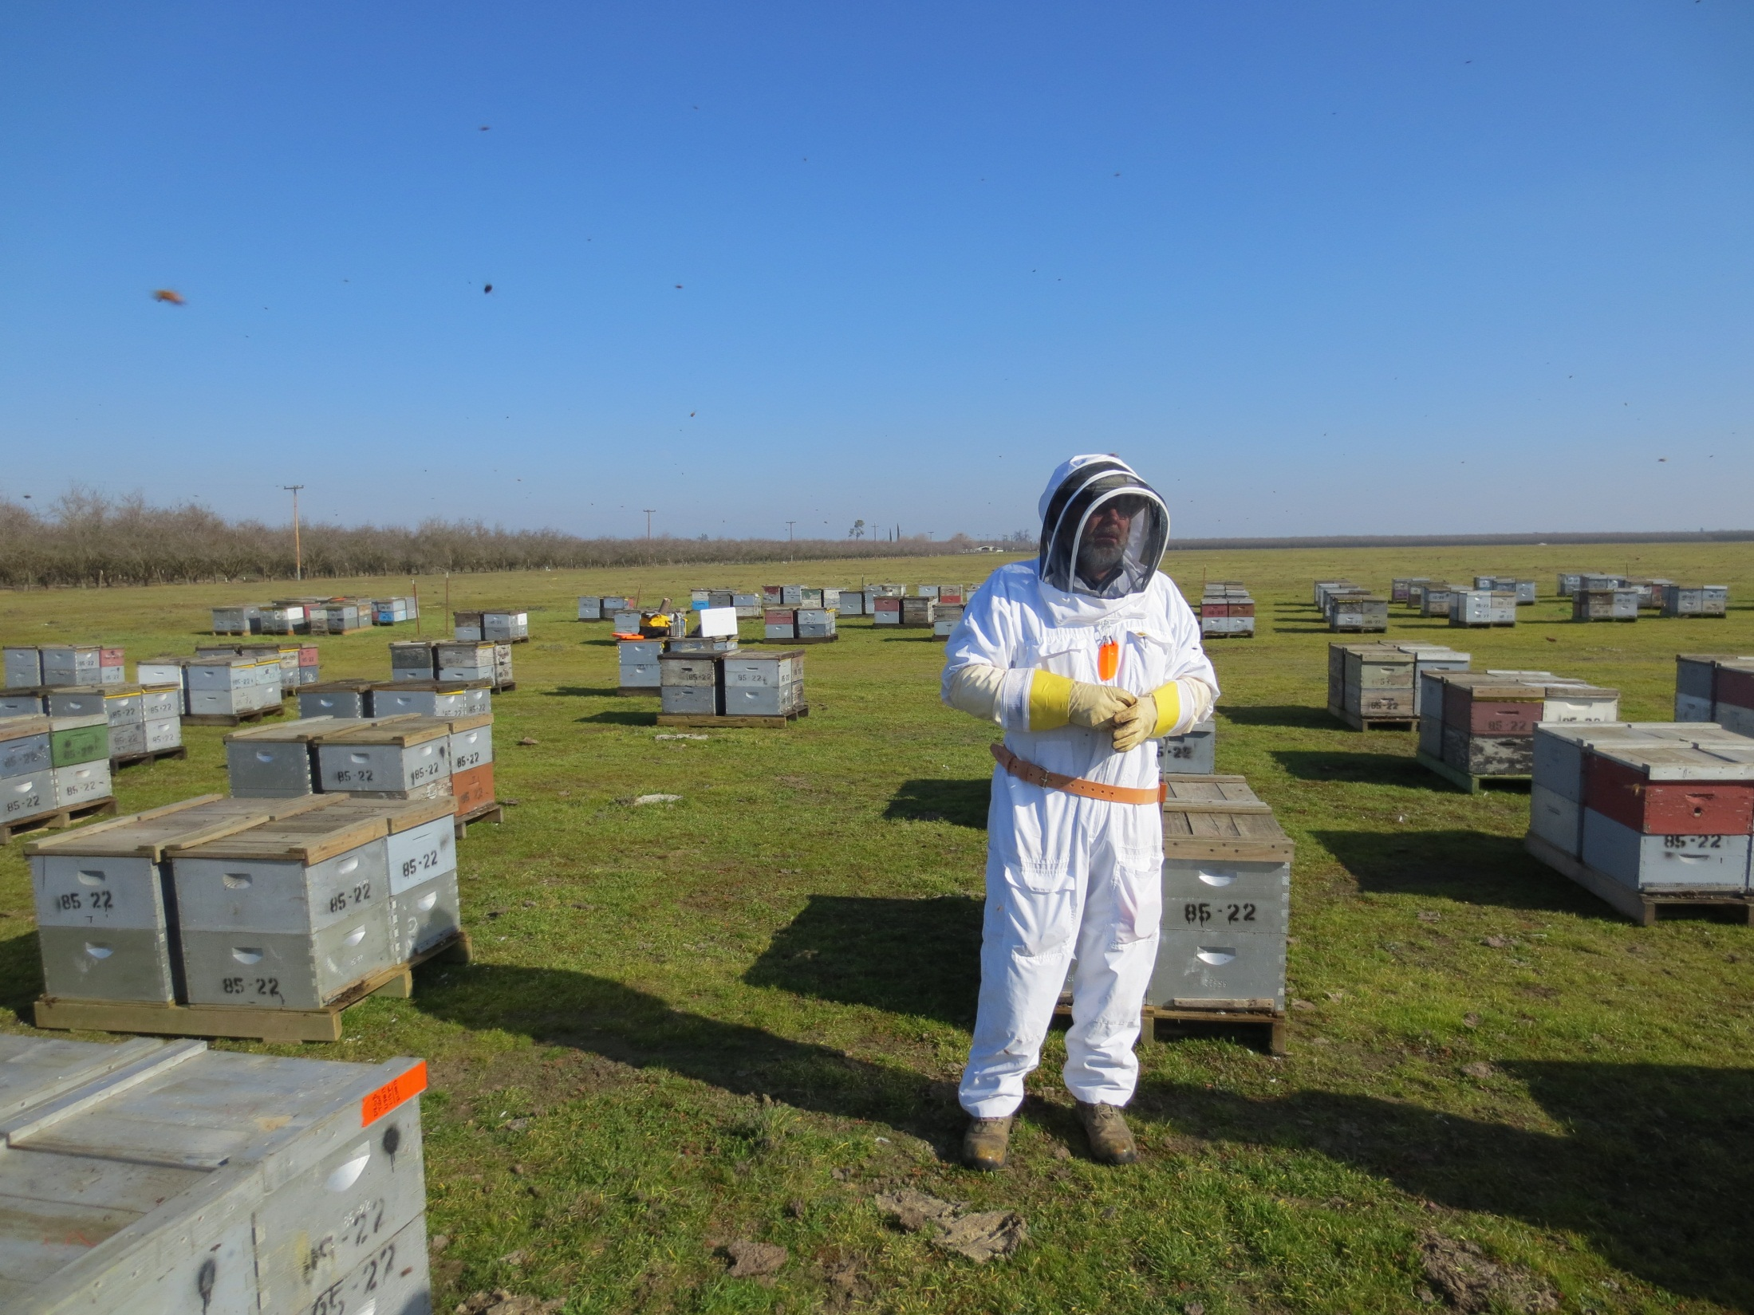
Commercial apiculture health needs to be protected to ensure large scale pollination services are available for insect pollinated crops

Slide 17
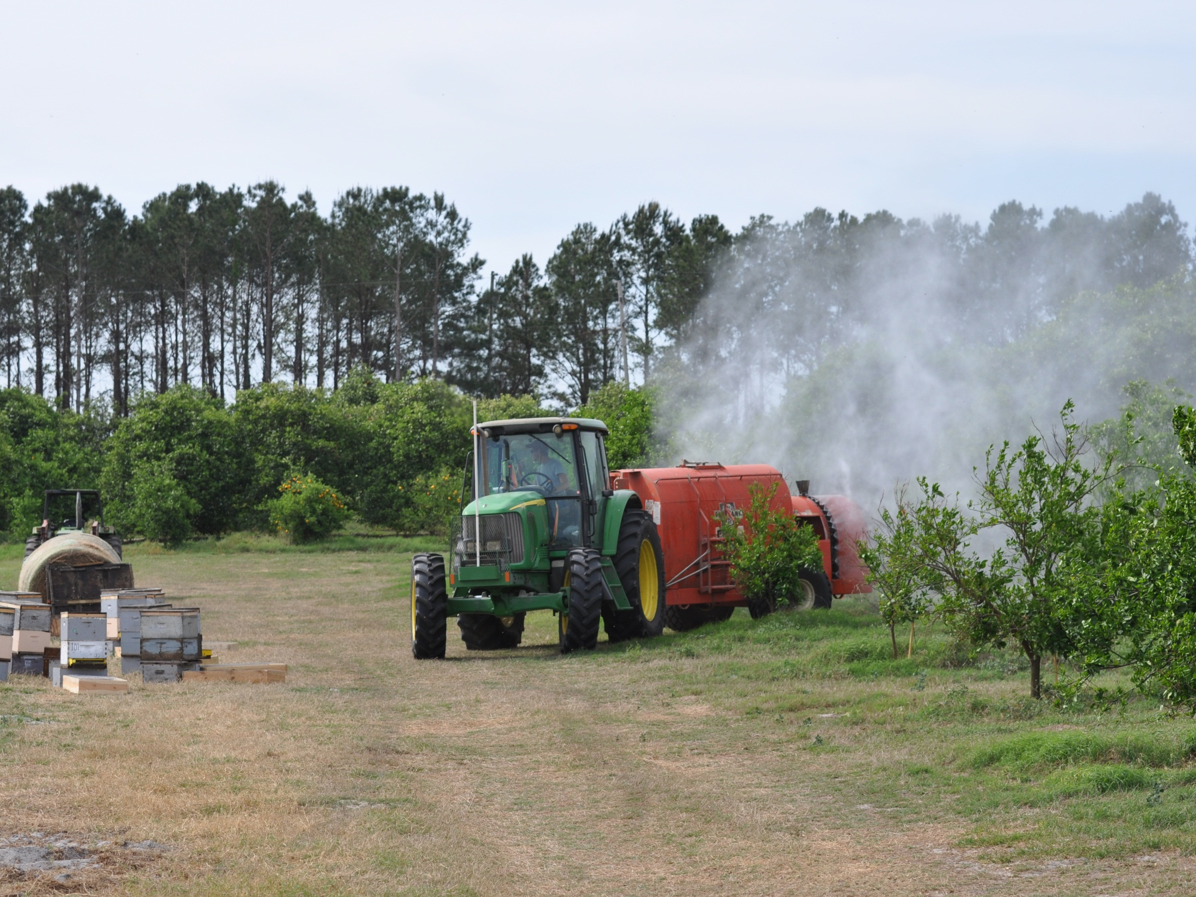
Crop health needs to be protected to ensure and improve yield and quality
Crop production agriculture and apiculture must and can coexist

Slide 18
Managed Honey Bee Colonies Worldwide
Trends Across Continents
35.000.000
Asia
30.000.000
45% increase globally
25.000.000
20.000.000
Africa
15.000.000
Europe
10.000.000
5.000.000
South America
North America
Central America
0
Oceania
Data source: FAOSTAT (http://faostat.fao.org/site/573/DesktopDefault.aspx?PageID=573)
Page 17

Slide 19
Hives and Beekeepers in Canada
Data source: CANSIM Tables 001-007: Production and value of honey
Notes:
1940-50 showed a buildup of beekeepers and colonies during the war, when sugar was embargoed; after the war was over, the need for honey declined (sugar available again) and colonies and beekeepers declined (1st red arrow)
then a slow buildup of colonies over 40 or so years until the late 1980’s when Varroa and Tracheal mites started to appear in the United States; what is now the CFIA (and what was then the Food Production and Inspection Branch of Agriculture Canada) closed the borders to US bees (up until that point, beekeepers especially in the west found it cheaper and easier to buy new bees every year rather than overwinter them)
Start of the modern era of beekeeping (Varroa, growth of professional beekeepers, overwintering techniques) (2nd red arrow)
Now, Canadian beekeepers need to overwinter – and have learned that it’s not easy some years; especially the last 6 or 7
Slowly and surely, honey production and colony numbers over the years have been increasing (dynamics in honey production due to lots of reasons including weather and price of honey)
What's been steadily decreasing? The number of beekeepers… why? It’s harder to keep bees; more difficult to have a profitable and sustainable operation – a gap is growing between professional and hobby beekeepers
Generally, in Canada, overall honey production has consistently continued to increase over the years; the number of colonies has been dynamic due primarily to market forces and pests; beekeeper numbers continue to decline in the face of increasing colonies (growth of professionals and larger operations, growth of pollination, decrease of hobbyists)
Data source: CANSIM Table 001-007: Production and value of honey

Slide 20
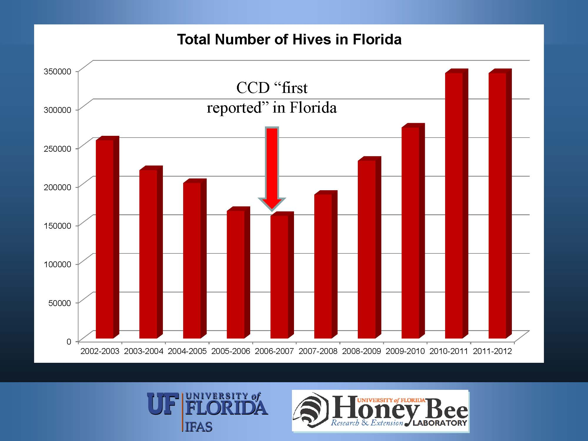
2006-2007

Slide 21
Beekeeping on the Rise in Europe
…overall numbers of honeybee colonies increased by 7% (in Europe) …between 2005 and 2010.
_________________________
BBC News: Science and Environment, 08 Jan 2014
Page 20

Slide 22
Underlying Causes

Slide 23
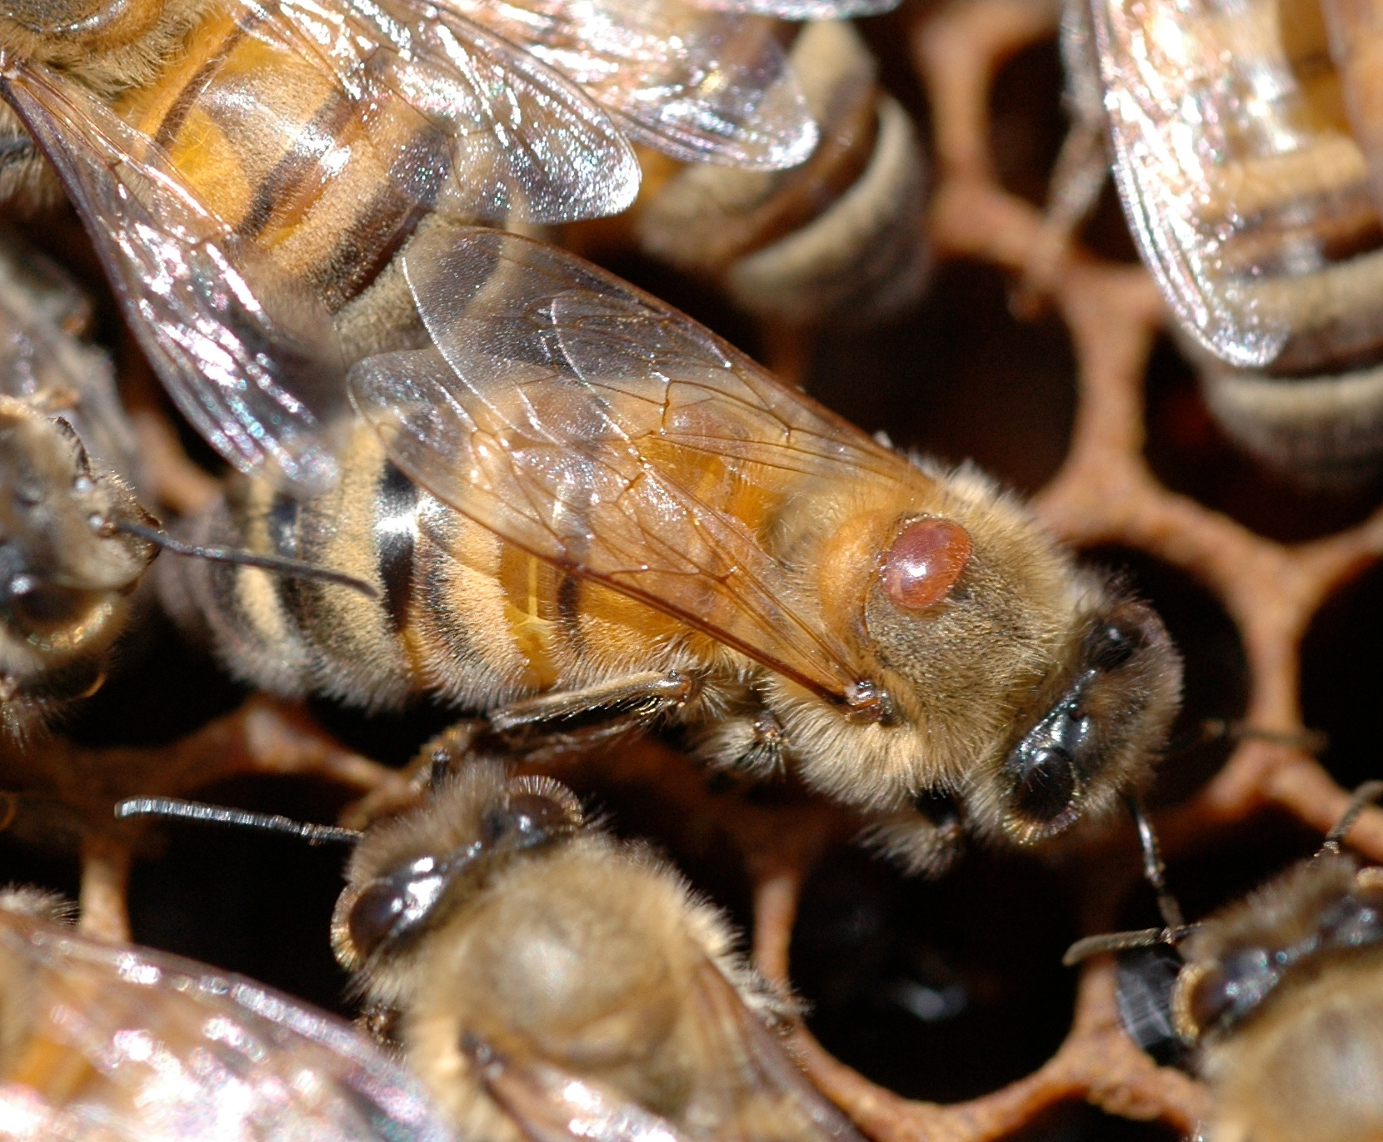
Varroa destructor
Vampire of the bee world & #1 enemy of honey bees
There are no “healthy” colonies

Slide 24
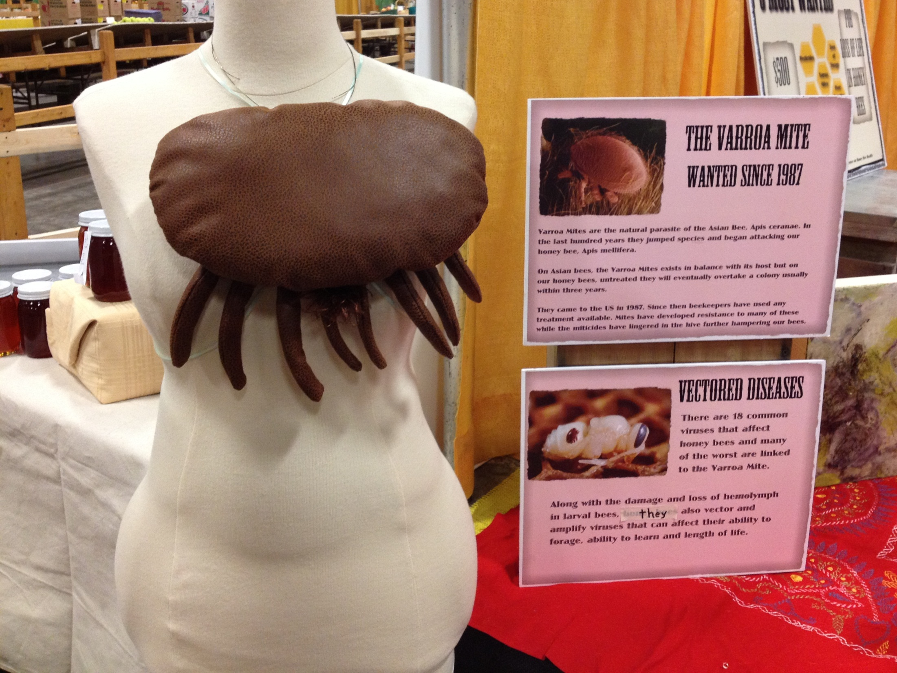
What if…?

Slide 25
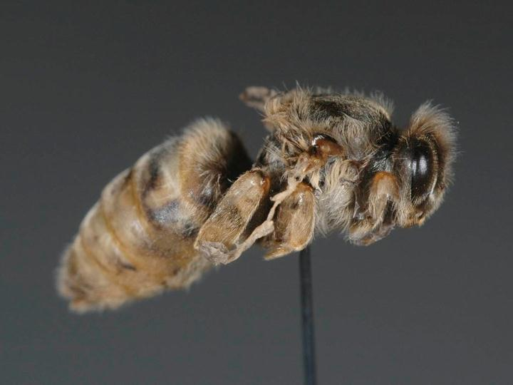

Deformed-Wing Queen
Nova Scotia Institute of Science
Halifax, NS, 6 April 2009
♥ 2009 REL Rogers, Wildwood Labs Inc.
Notes:
Collected pre-emergent queens in dead bee traps in Arizona. This confirms that DWV can have an impact on queen replacement in a hive.

Slide 26
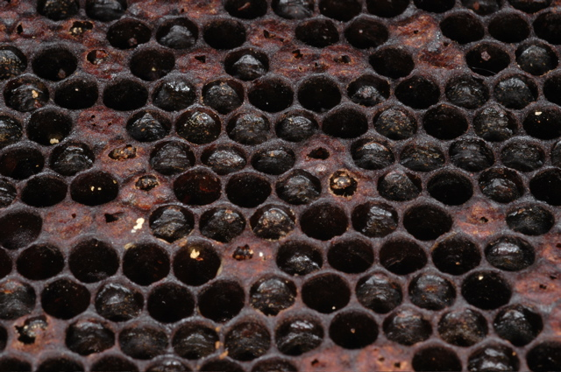
American foulbrood

Slide 27
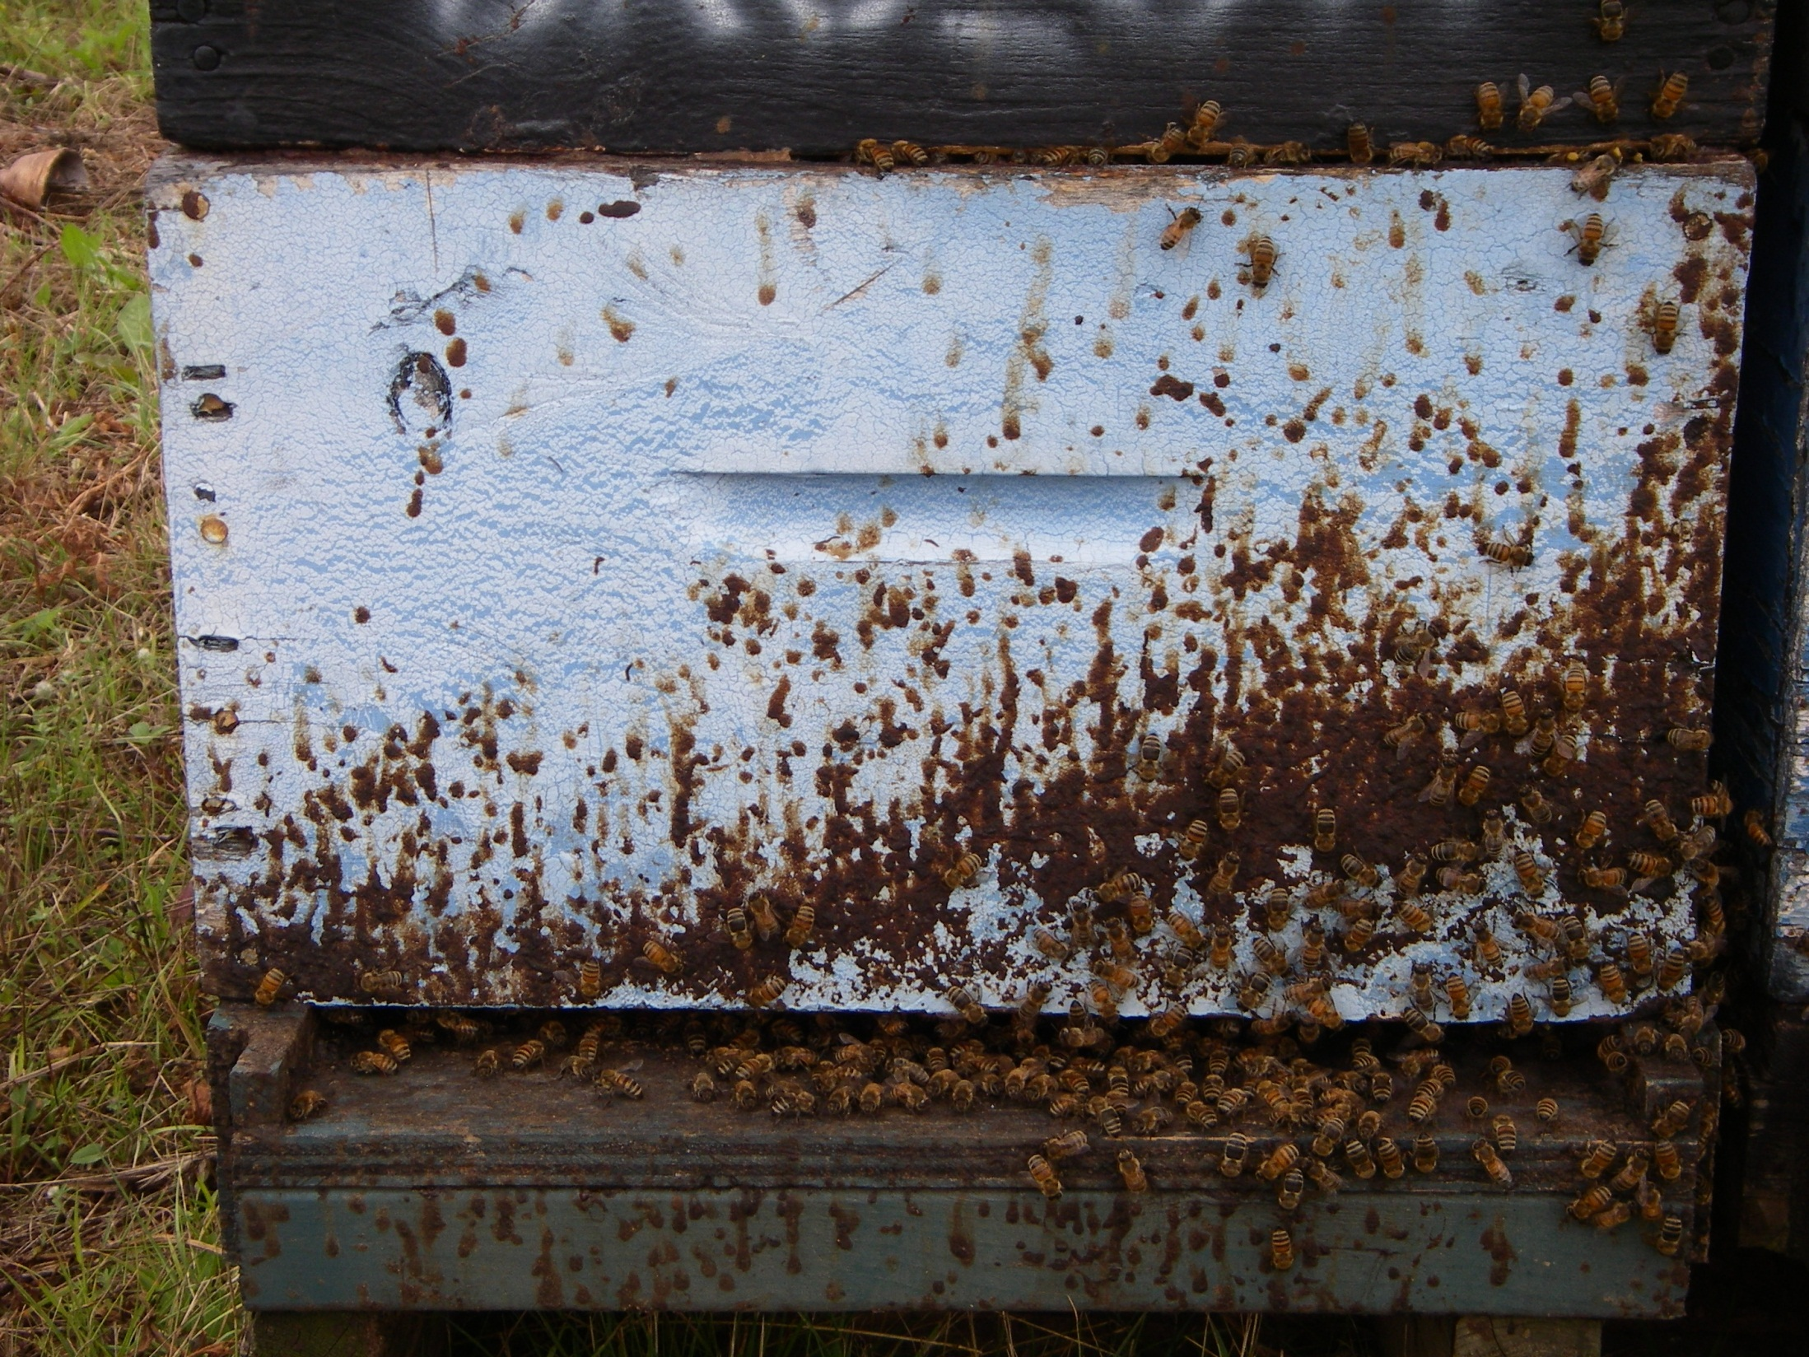
Nosema and Other Biotic Factors

Slide 28
Pollen
Honey
Wax
Bees
Crop and Bee Protection Products
Nova Scotia Institute of Science
Halifax, NS, 6 April 2009
♥ 2009 REL Rogers, Wildwood Labs Inc.
Notes:
Some protocols call for samples for residue analysis.

Slide 29
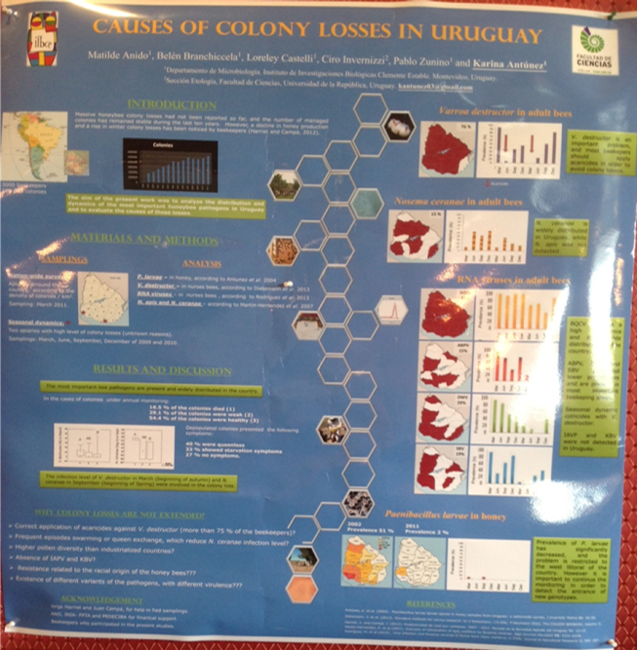
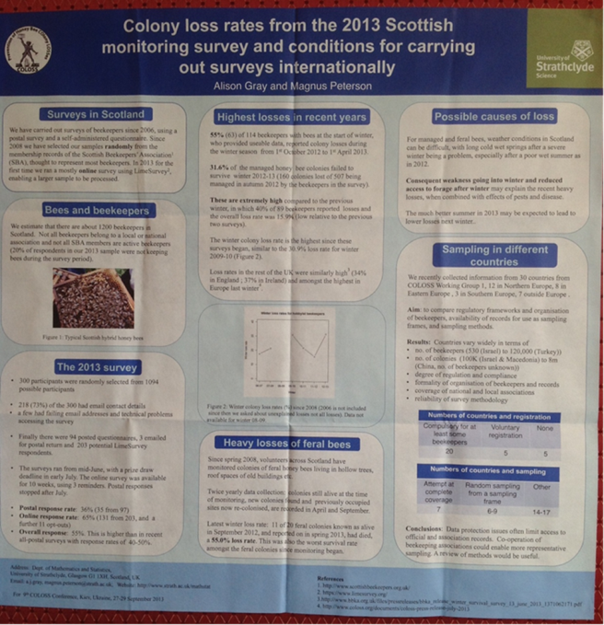
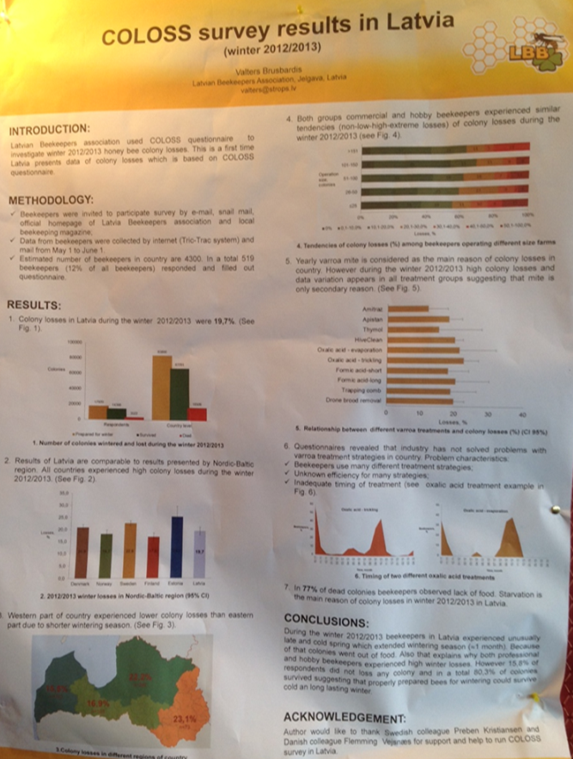
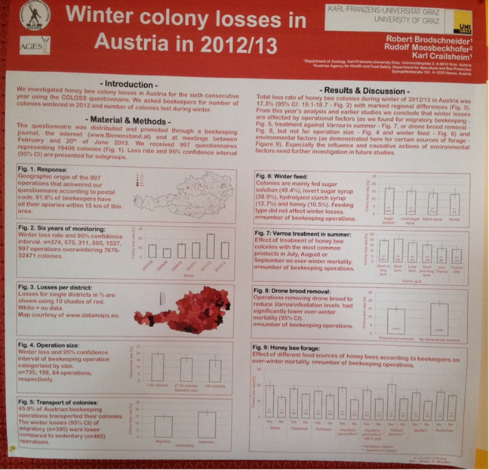
Reported Causes of Losses
2012/2013
COUNTRIES
  Latvia
  Scotland
  Alberta, Canada
  Uruguay
  Austria
  Holland
  Hawaii
  New Zealand
LOSSES ATTRIBUTED TO
  Varroa, Nosema,Viruses
  Queen issues
  Starvation
  Severe weather
  Knowledge of beekeeper
  “Operational factors”

Slide 30
Categories of causal factors
Increases
Queens
Knowledge
Wintering
Seasonal
Management
Environment
In-hive
Management
Monitoring must include:
Apiary suitability
Management
Colony strength and health
Environment
Pathogens
Predators
Parasites
Resistance
Toxins
Water
Food
Shelter
Safety
Weather
In-hive

Slide 31
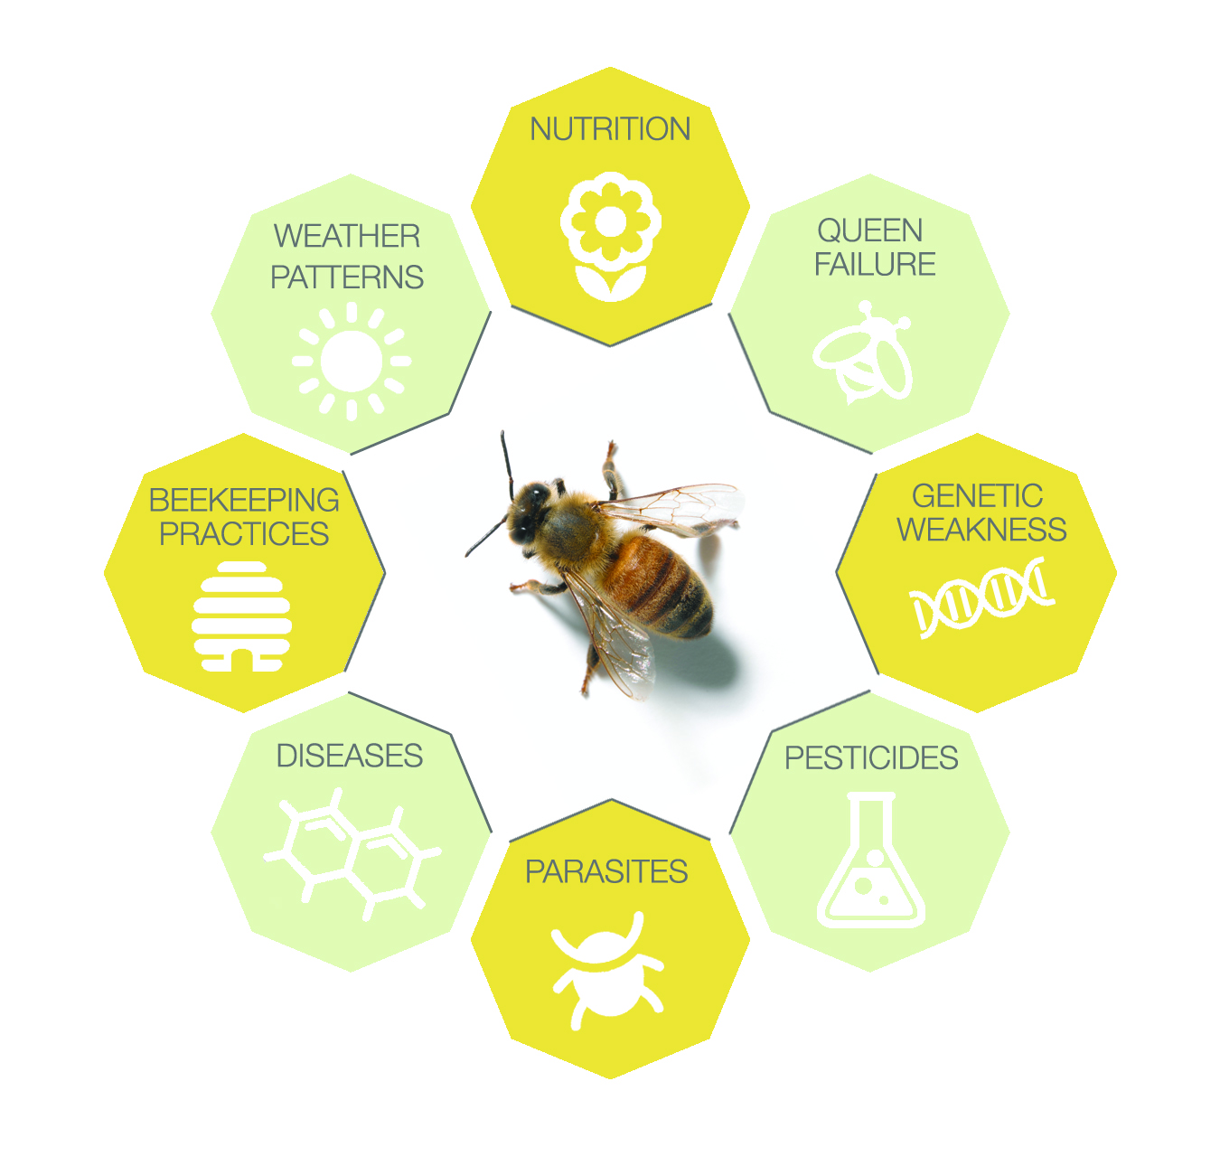
Multiple Stressors Affecting Honey Bee Health
There is no single causal factor and there are many interactions of multiple factors:
  Parasites (e.g. mites)
  Nutritional deficiencies
  Pathogens
  Weather events
  Beekeeping practices
  Pesticides (for bee and crop protection)
  Genetic characteristics
  Queen issues
  Predators (vert and invert)
  In-hive environmental conditions

Slide 32
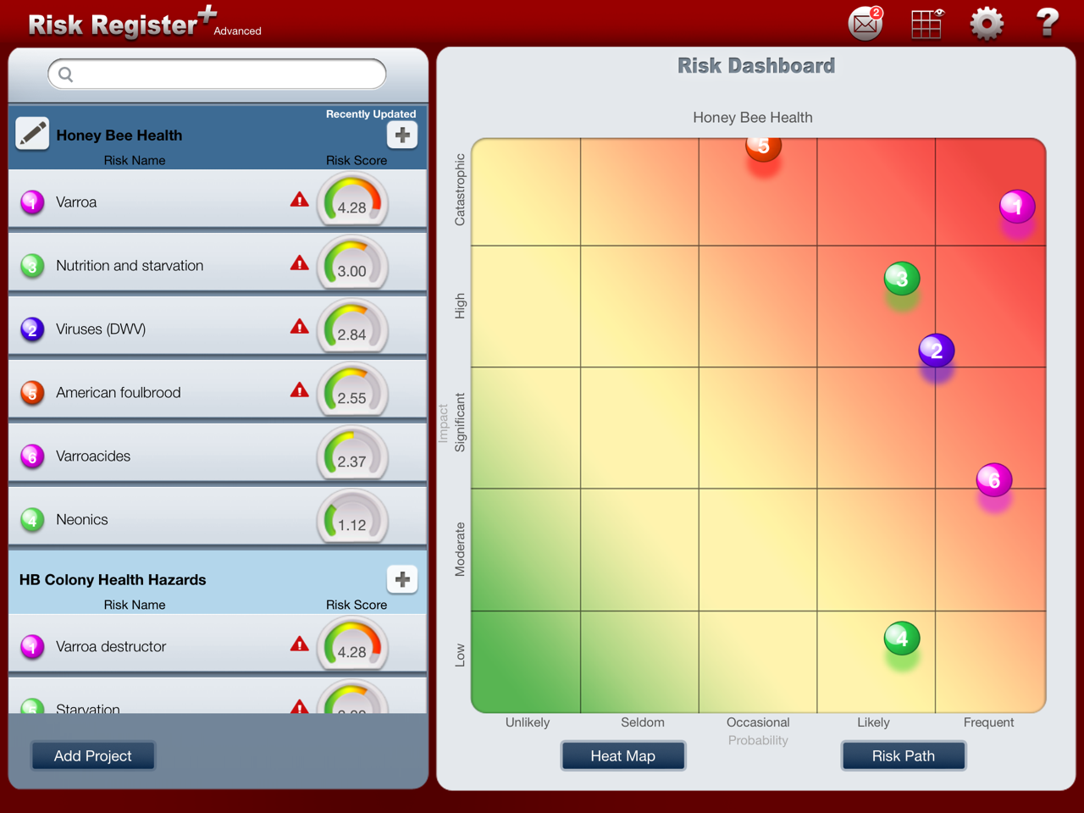
American foulbrood
Varroa
Nutrition & Starvation
Viruses
Varroacides
Neonics

Slide 33
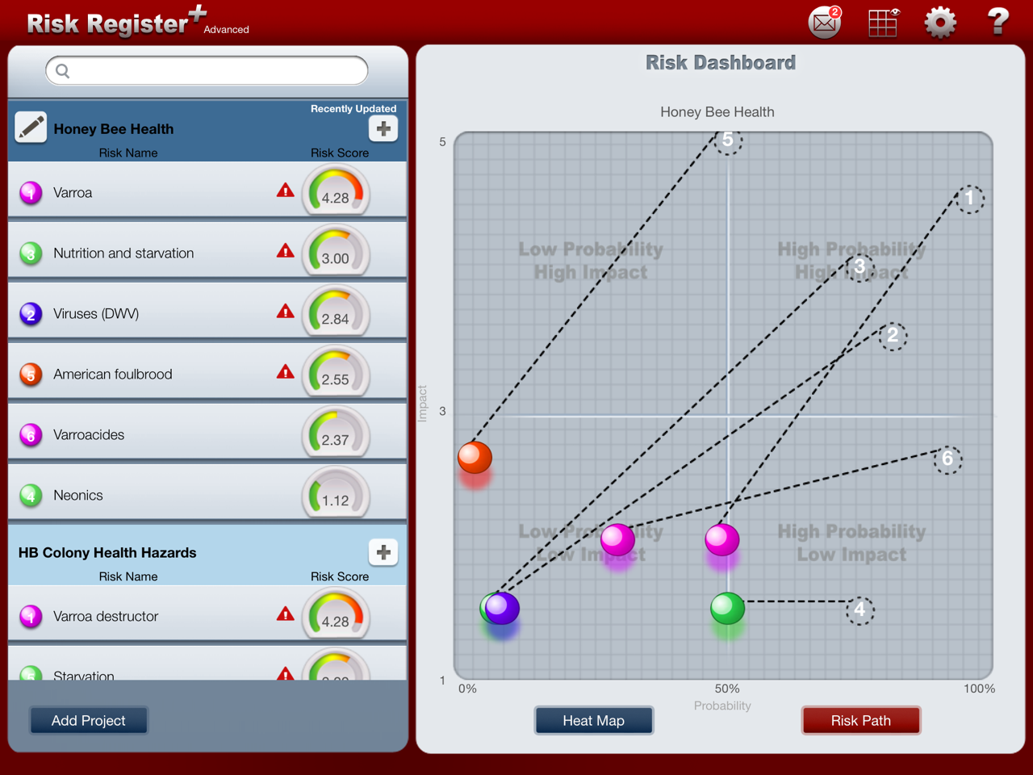
American foulbrood
Varroa
Nutrition & Starvation
Viruses
Varroacides
Neonics

Slide 34
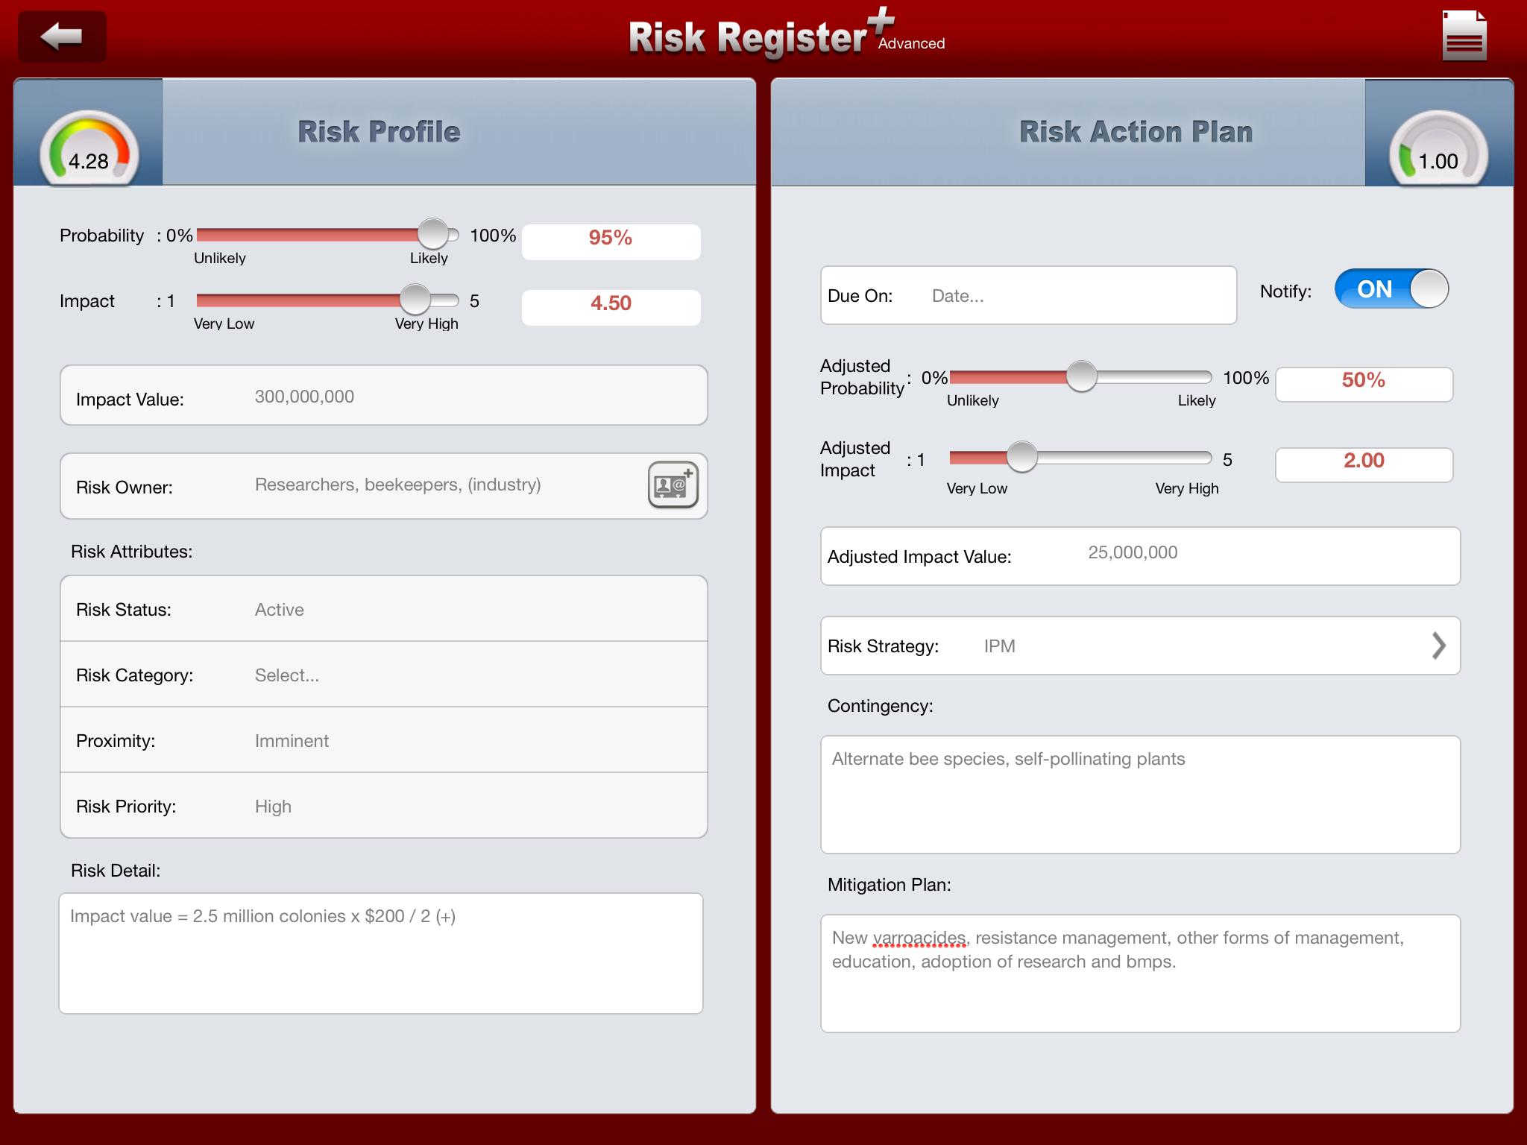

Slide 35
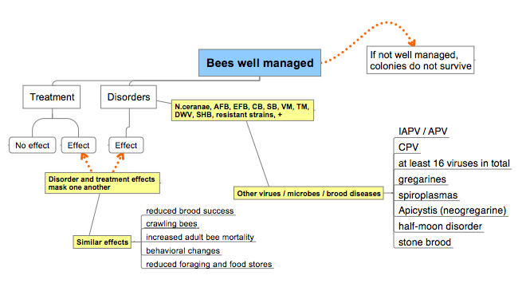
How Honey Bee Health Affects Research
POST-VARROA
?
/ KBV
*
melanosis
*
Lipa and Triggiani (1996)

Slide 36
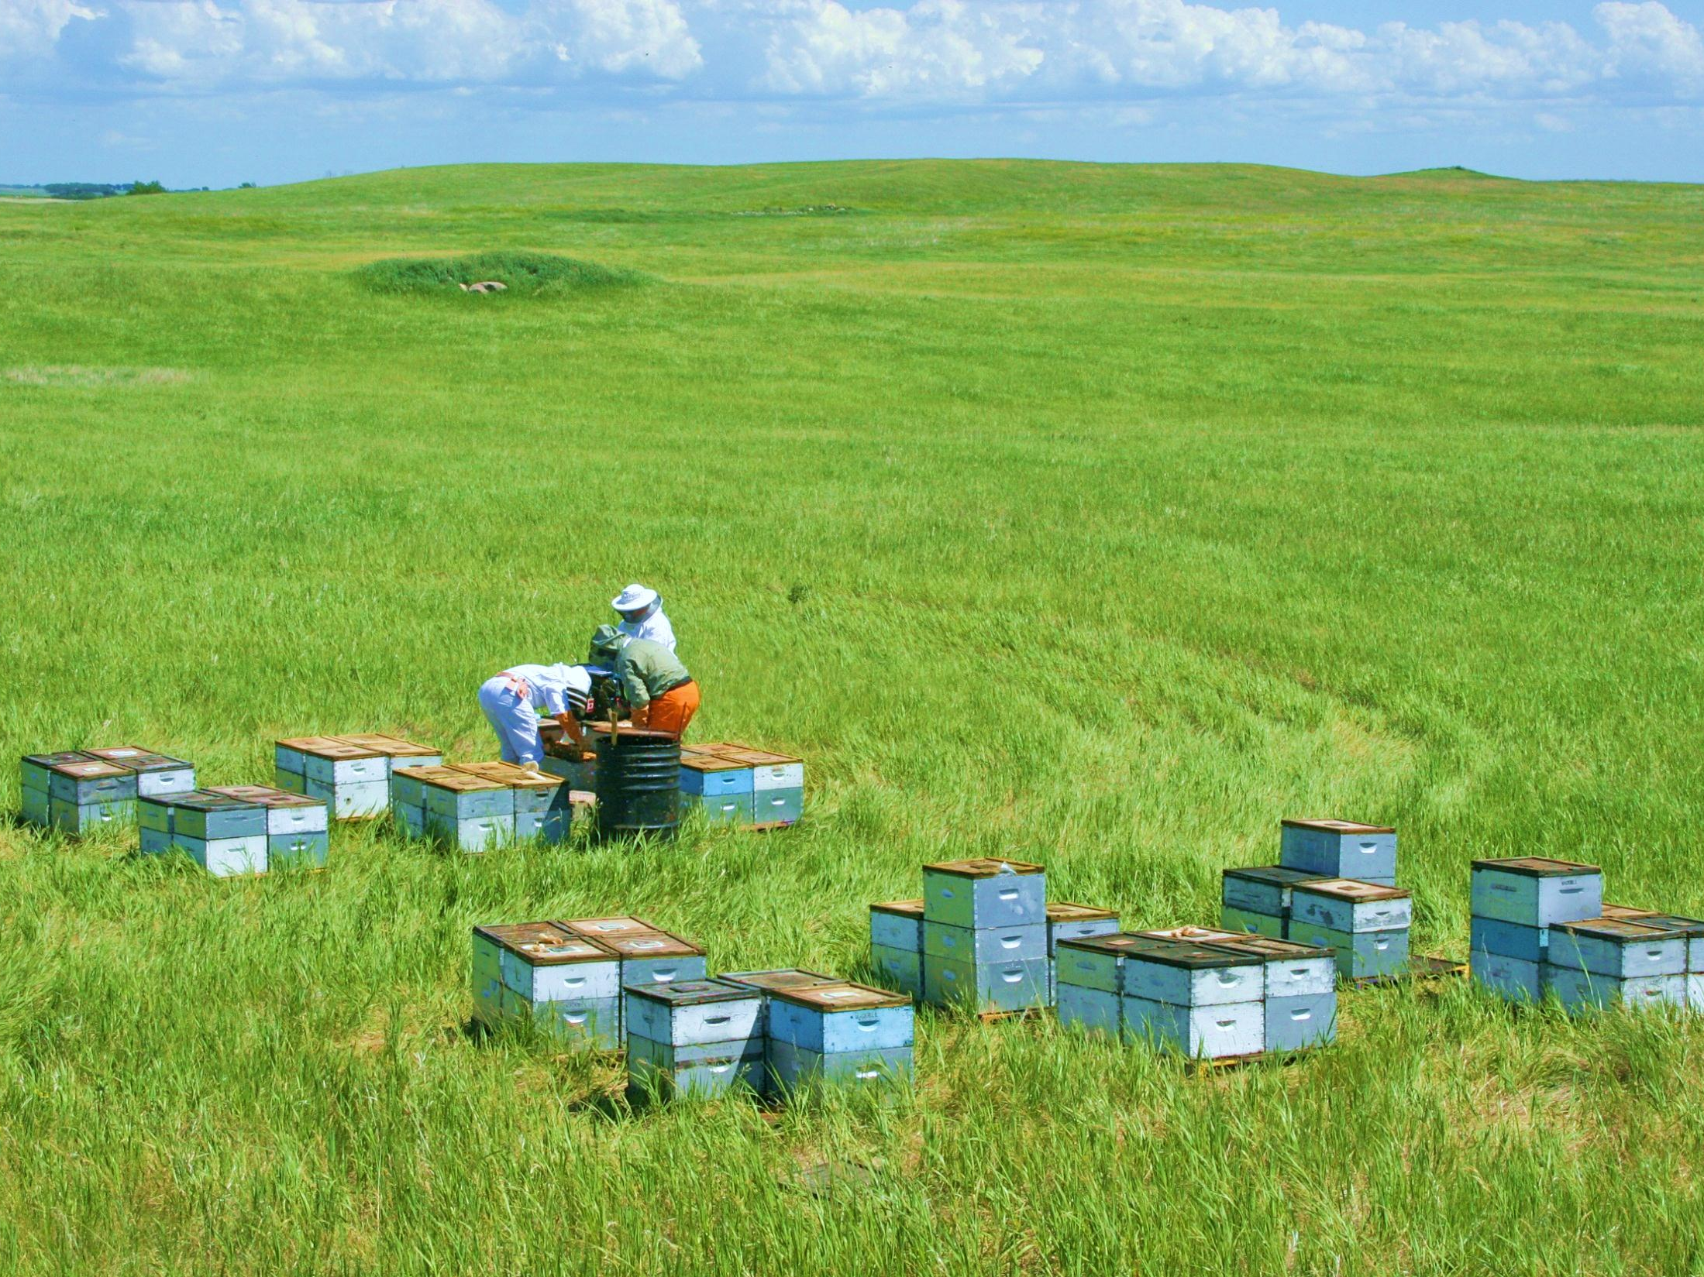
Apiculture in Transition
Notes:
Need to shift focus from just the honey bee and the colony, to considering the practice of apiculture

Slide 37
Apiculture in Transition
Since the mid-1980s, the following changes have occurred
  Parasitic mites (Varroa and tracheal mites)
  Nosema ceranae and Small hive beetle
  New viruses and more effective vectoring
  Nutritional issues
      Reductions in forage (e.g. CRP land)
      Excessive competition (e.g. crop pollination such as almonds)
      Forced to work forage of poor nutritional quality (e.g. corn)
  Increasing demand for pollination services
      e.g. almond and lowbush blueberry
      Strength standards (difficult to do at the time of season needed)
      Timing and exceeded carrying capacity (often limited or no bee forage)
      More rapid spread of parasites, pathogens
      Long-haul transport of unhealthy colonies and associated stresses

Slide 38

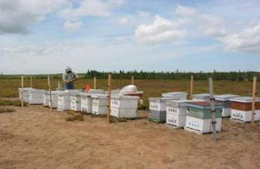
The Changing U.S. Honey Bee Industry (also Canada and Europe)
    Previously: Honey and Hive Products
    Increasingly: Pollination Services
Almond pollination requires approximately 1.6 million of the 2.6 million colonies in the U.S. and is a driver of the number of colonies

Slide 39
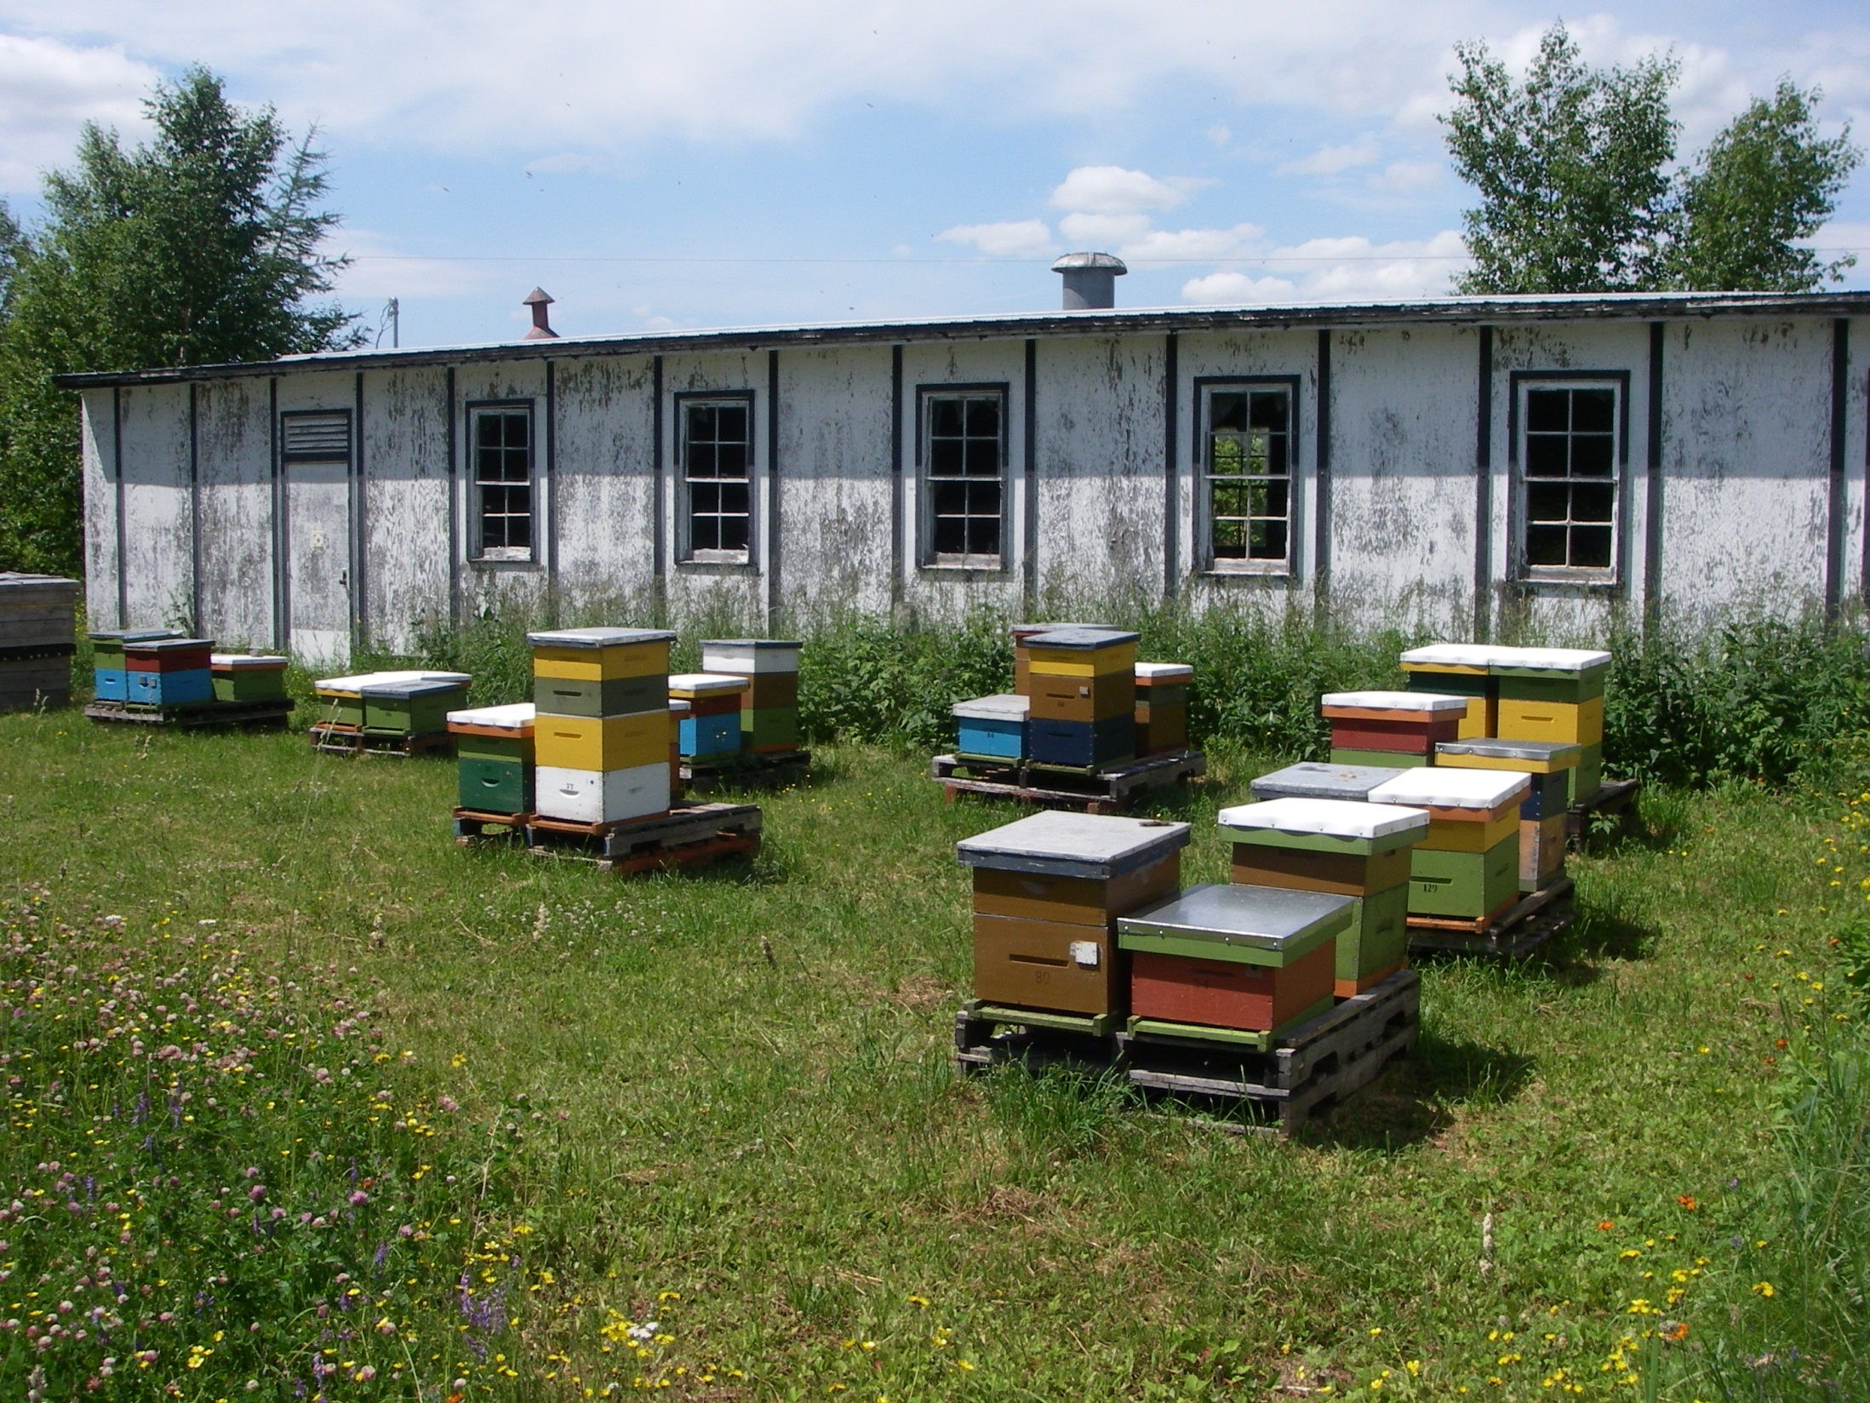
Hobby/small scale -> Large scale commercial
In the past, fewer colonies primarily for honey production from wild areas
Apiculture is in Transition

Slide 40
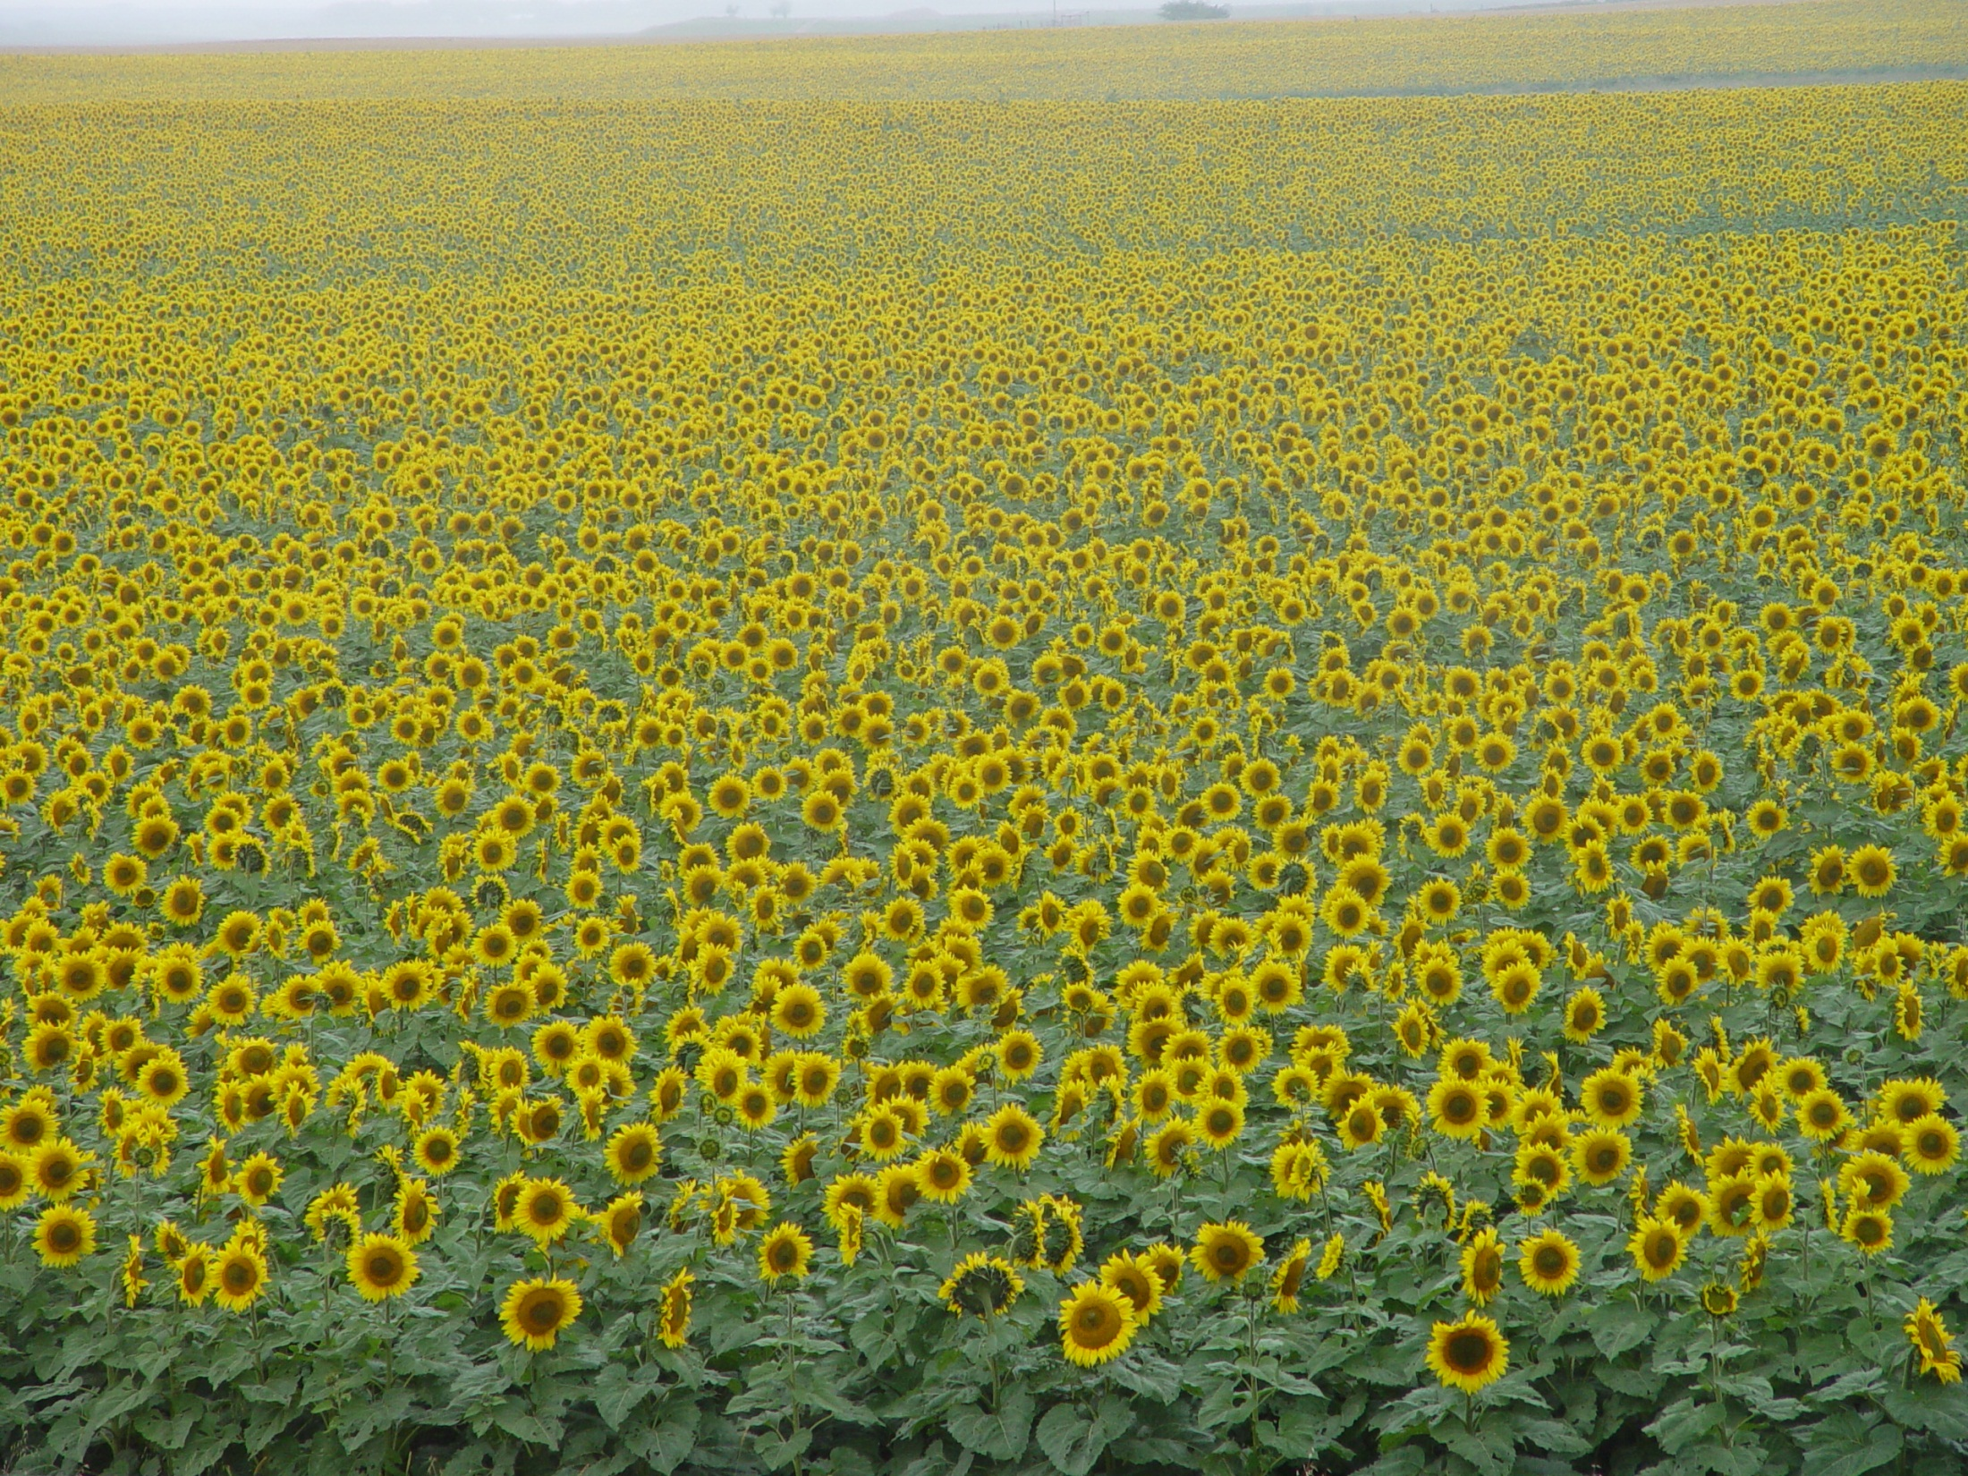
Now, large numbers of colonies in mono-crops for honey production or pollination

Slide 41
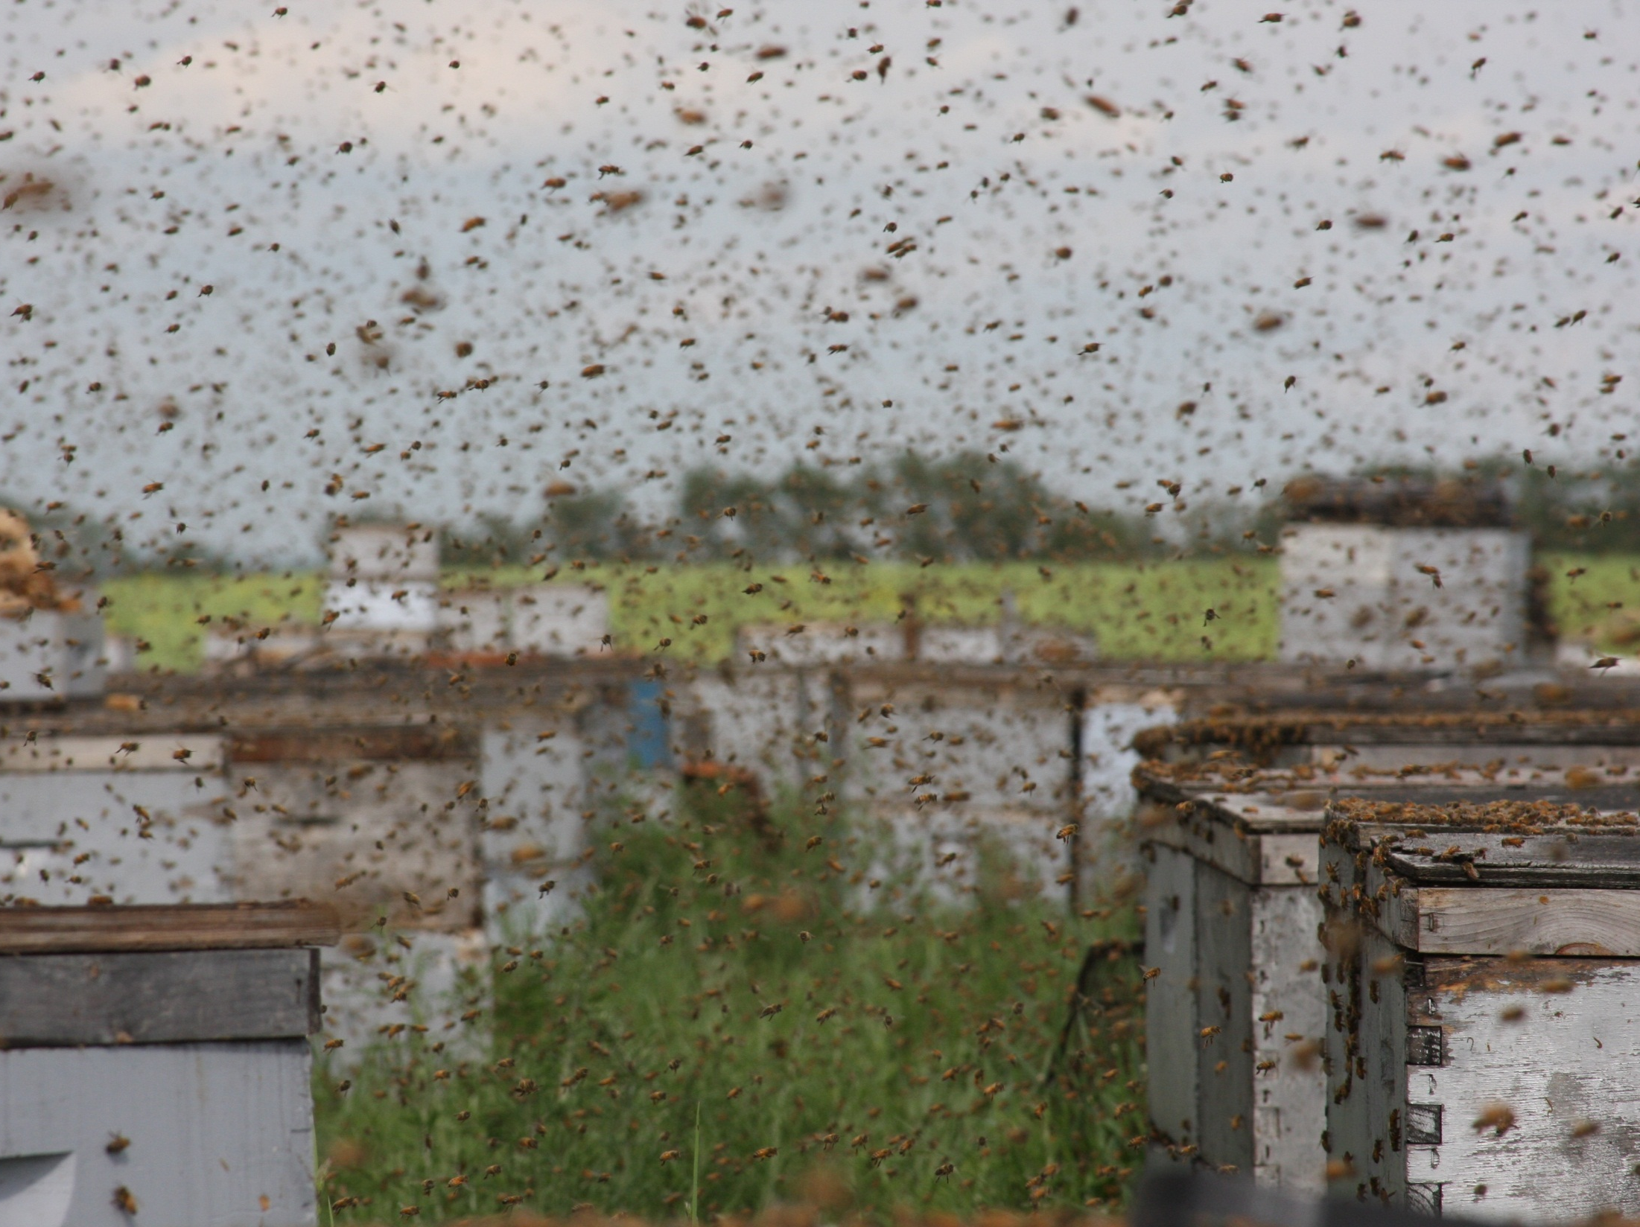
Tendency is for mass overstocking for pollination

Slide 42
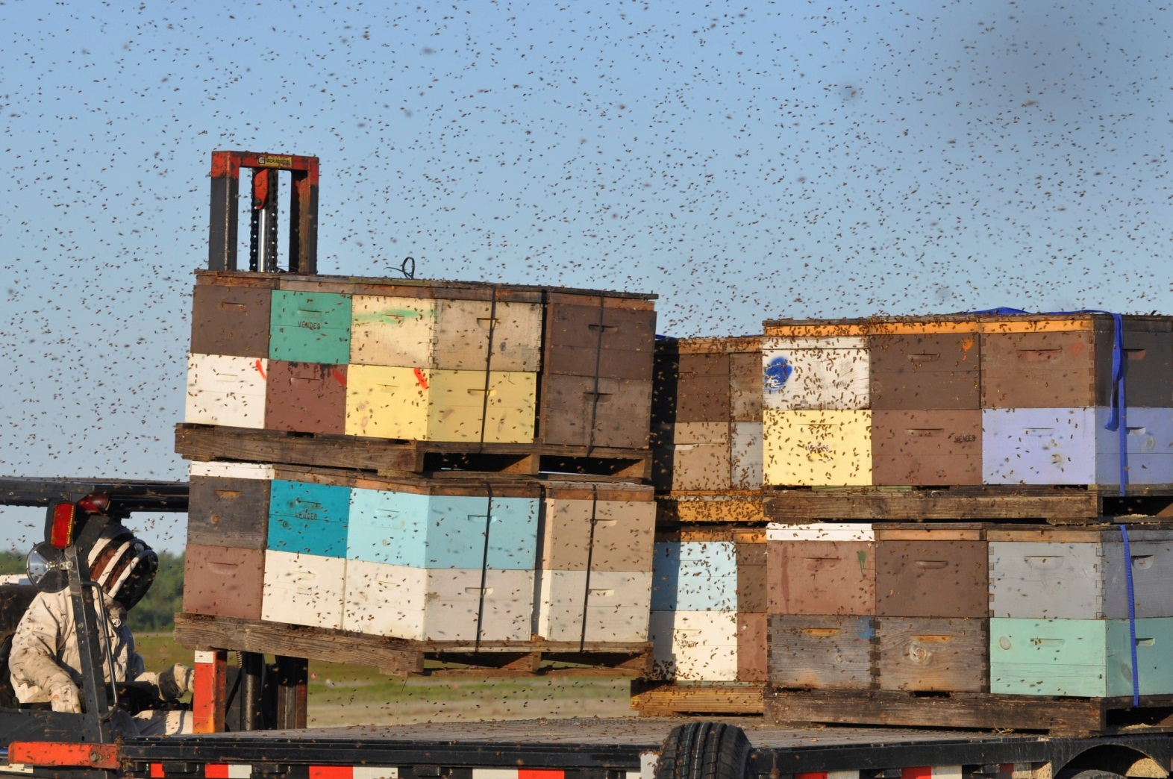
Modern apiculture imposes many risks and stressors

Slide 43
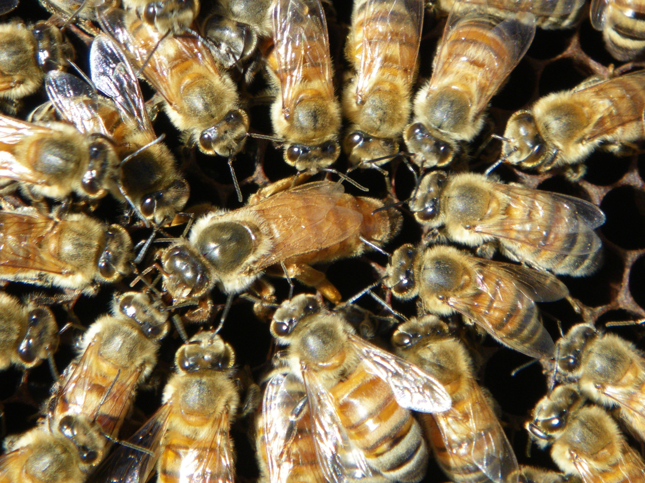
Apiculture is Agriculture Too:
The production and management of animals for products and services

Slide 44
Solution Overview

Slide 45
Crisis Recovery Theory
New Vitality/
Best Management Practices
Normal /
Familiar
Foreign Element
(e.g. crops / mites)
Rebuilding /
Adapting / Continual improvement / Collaborations & Partnerships
We are here
Chaos
(denial /
frustration / anger / blame)
Decision to
Change
(Transition occurs)
Reflection /
Coping / Self assess
Slide 44

Slide 46
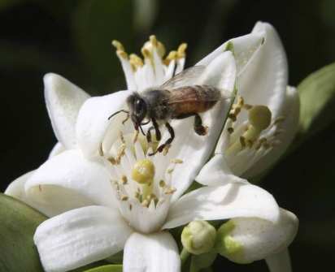
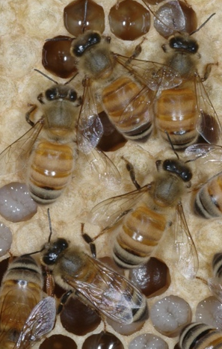
The Solution
(to ensure the future of apiculture)
COMPONENTS OF THE SOLUTION
Improved monitoring and diagnoses
Integrated Pest Management (IPM) for Varroa destructor /other pests
Integrated Bee Management & BMPs
Supportive Agricultural Policies
Willingness to work together
Communication (open, honest, informative)
Collaborations & Partnerships
45

Slide 47
Working Toward Positive Impact

Slide 48
Seed Treatment Research and Risk Mitigation
Seed coatings
Flow agents
Awareness and communication
Handling practices
Understanding routes of exposure
Corn Seed Dust Research Consortium
Other (e.g. bee repellents)
Page 47

Slide 49
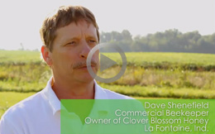
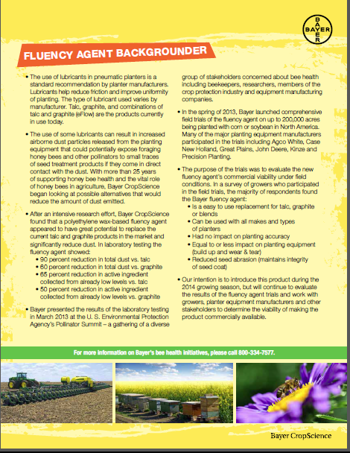
Field Trial Results for
Fluency Agent Announced
  Alternative planter lubricant that could replace talc and reduce dust emissions from planters
  Significant decrease in both total dust (90 percent) and active ingredient dust emissions (65 percent) have been observed from vacuum exhaust of planters in laboratory testing
  Bayer is distributing the Fluency Agent through seed companies and equipment manufacturers in the U.S. and Canada so that it is available for growers during the 2014 planting season

Slide 50
What Growers Can Do To Help
Become informed about apiculture and how to coexist
Be aware of shared spaces
Actively be part of the solution
Stay positive and tolerant
Read articles with a critical eye
Support healthy bees AND healthy crops
Communicate, discuss and share ideas
Follow labels and err on the side of safety if label language open to interpretation
Page 49

Slide 51
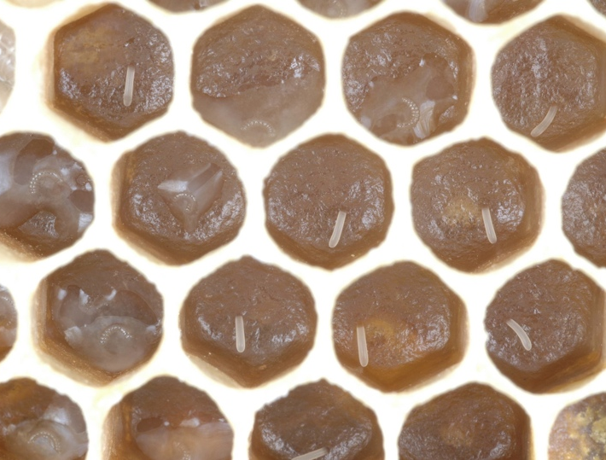


The 3Ms
Monitoring
Management
Mite control
Franklin County Beekeepers’ Association
North Carolina, 26 August 2009
♥ 2009 REL Rogers, Wildwood Labs Inc.

Slide 52
Bayer Bee Care Program

Slide 53
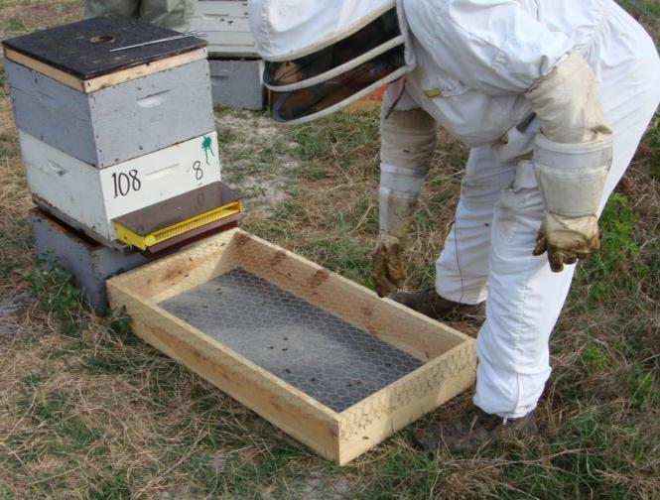
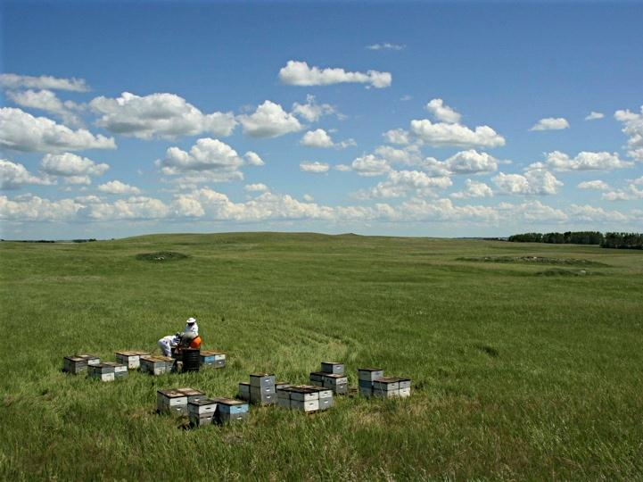
Supporting Bee Health for 25 Years
  Products to control parasitic mites in honey bee hives
  Research and development of other technologies (e.g. monitoring & IPM tools, other effective compounds)
  Extensive and improved testing to assess safety to beneficial arthropods
  Fostering advancements in stewardship

Slide 54
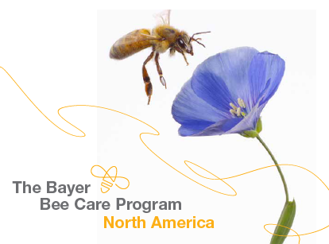
Bayer Bee Care Program - NA
A holistic program that:
  Consolidates and coordinates Bayer’s diverse internal efforts on bee health
  Identifies and facilitates partnerships and collaborations in bee health research and solution efforts
The four overlapping components of the Bayer Bee Care Program
  Identify issues and how to resolve them
  Communication of information (incl. awareness and training)
  Stewardship activities (incl. monitoring product use and training)
  Bee Care Center & bee health research

Slide 55
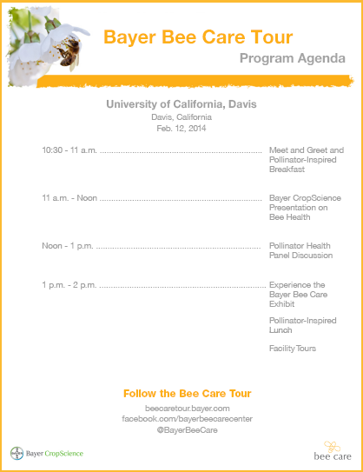
Bayer Bee Care Tour 2014
  General Program:
    Meet and Greet and Pollinator-Inspired Breakfast
    Bayer Presentation on Bee Health
    Pollinator Health Panel Discussion
    Experience the Bayer Bee Care Exhibit
    Pollinator-Inspired Lunch
    Facility Tours (only at UC Davis stop)

Slide 56
Bayer Bee Care Tour 2014
  Tour Execution
    West Coast (Hort Focus): WSU (Feb. 6); UC Davis (Feb. 12); OSU (Feb. 18)
    Commodity Classic (Feb. 27 – March 1): San Antonio
    Midwest (Crop Protection Focus): SD (March 12); Purdue (March 20)
    Environmental Science (ES) (e.g., Home Depot or Lowe’s
    District Meeting) (Q1 2014)
    Canada: University of Guelph (May 2014)
    National Pollinator Week (U.S. Botanic Gardens) (June 16-23)

Slide 57
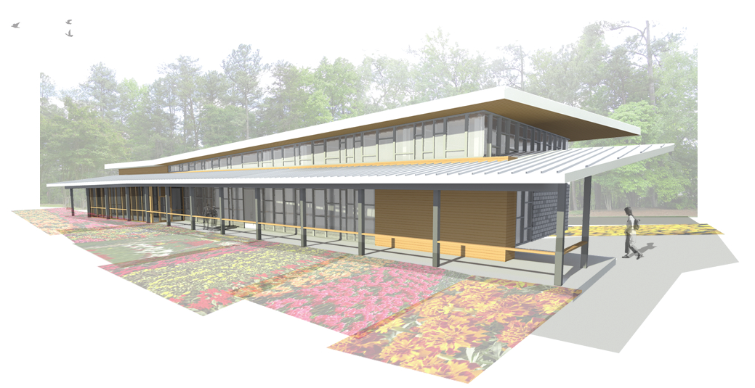
Bayer Bee Care Center – North America
Research Triangle Park, North Carolina
Dedicated to bee health research / education / training, biodiversity and sustainable agriculture
6,000 sq ft
Fully staffed
Lab & workshop
Meeting room and offices
Area for static and interactive displays

Slide 58
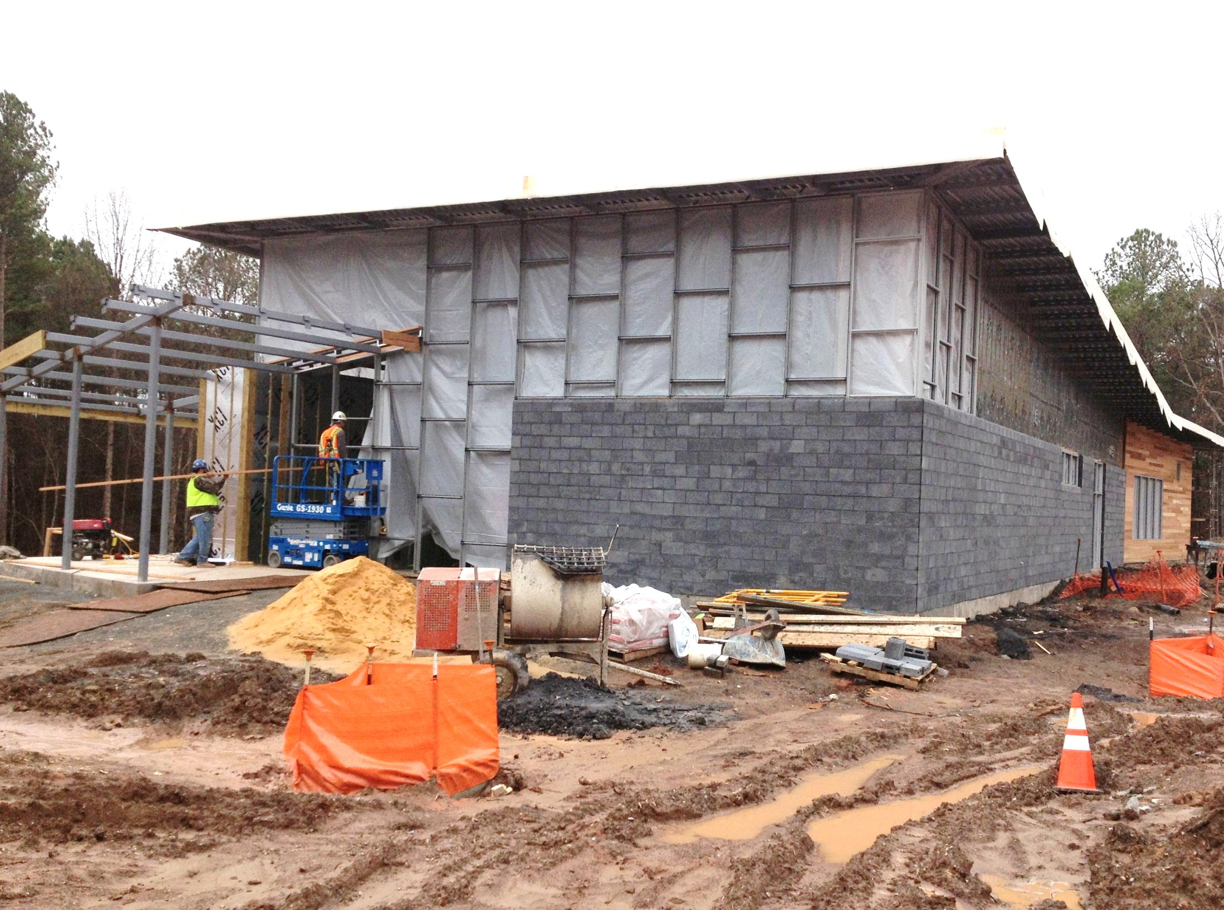
Bayer Bee Care Center – North America
Will open 15 April 2014
Bayer Bee Care Field Station, Clayton, NC
Dedicated bee health field research and support officially opens Nov 2014

Slide 59
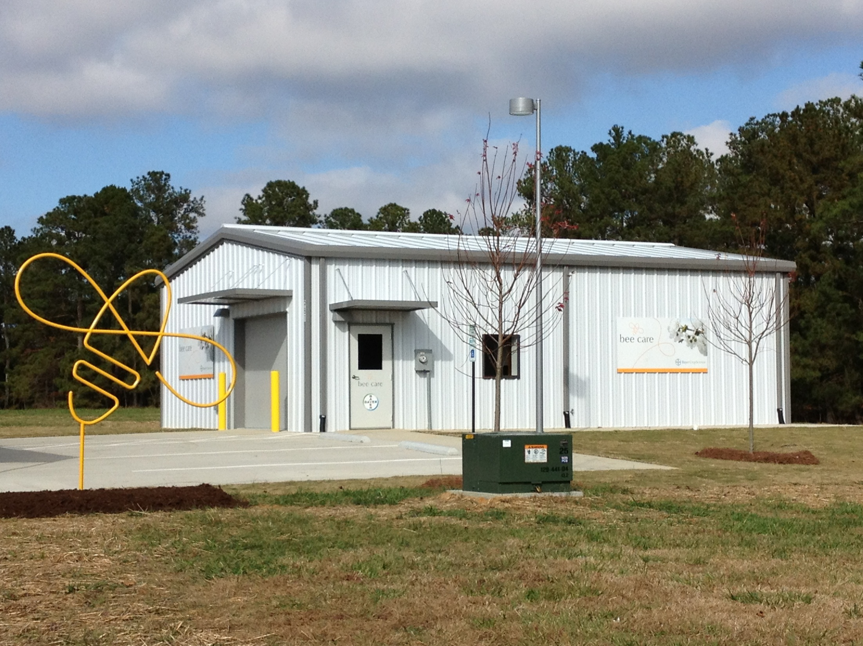
Bayer Bee Care Field Station, Clayton, NC
Dedicated to bee health field research and support; officially opened Nov 2013
~1,200 sq ft
Office
Workshop & Extraction
Cold storage room

Slide 60
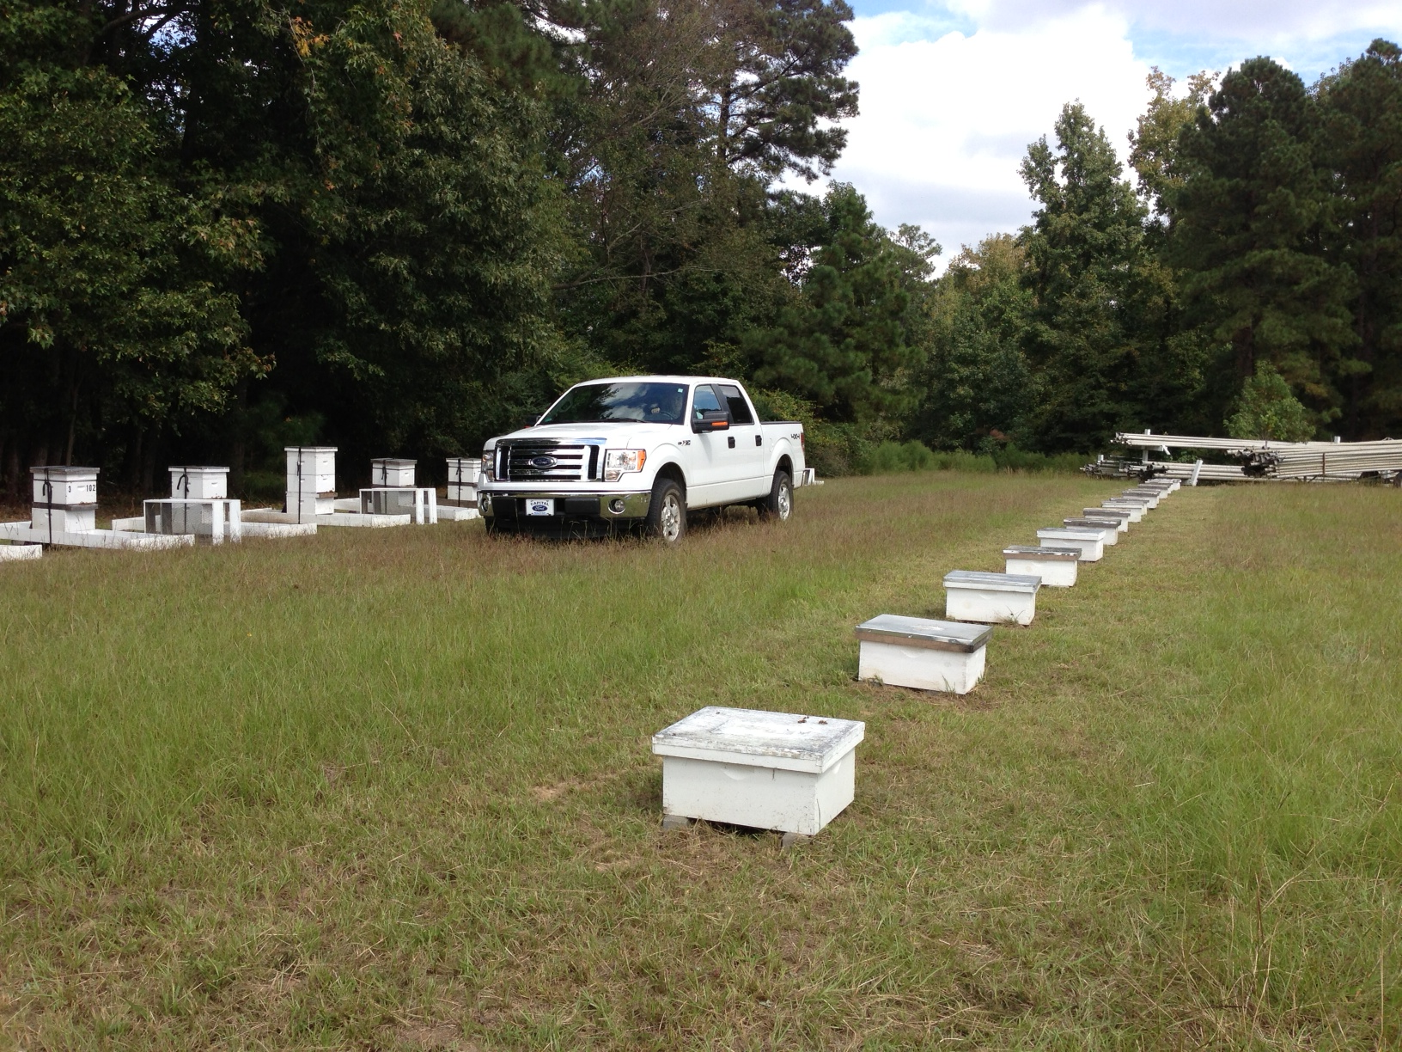
Beesboro
Bayer Bee Research Apiary, Clayton, NC

Slide 61
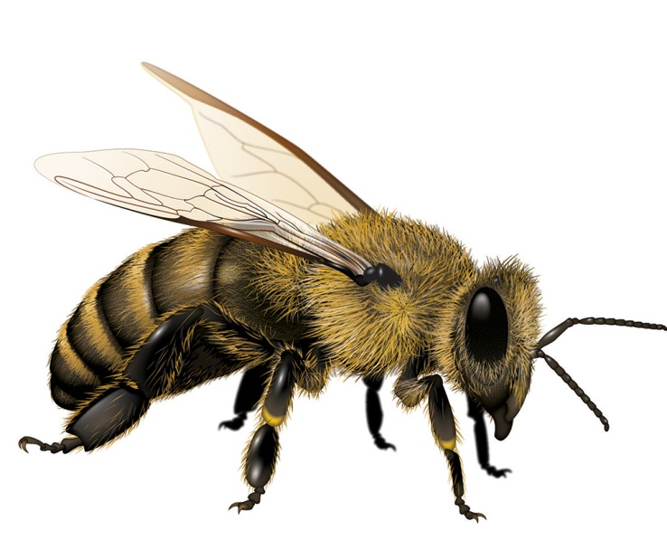
Selected Bee Care Center
Research and Activities
Healthy bees program
(monitoring, management, mite control)
VarroaBox evaluation for monitoring
Varroacide resistance testing to support new registrations
VarroaGate development, support and evaluation
Tech transfer / outreach / Beekeeper consultations / articles
Bee repellent R&D
Integrated varroa management / IPM
Varroacide screening and R&D
Nosemacide screening and R&D
Small hive beetle IPM
AFB potential novel treatment
Sentinel hives program (early warning & prediction systems)
Instrumented hives for remote, monitoring of hive conditions
Bee forage and nutrition
Collaborations ands partnerships
Bee Health Investigations

Slide 62
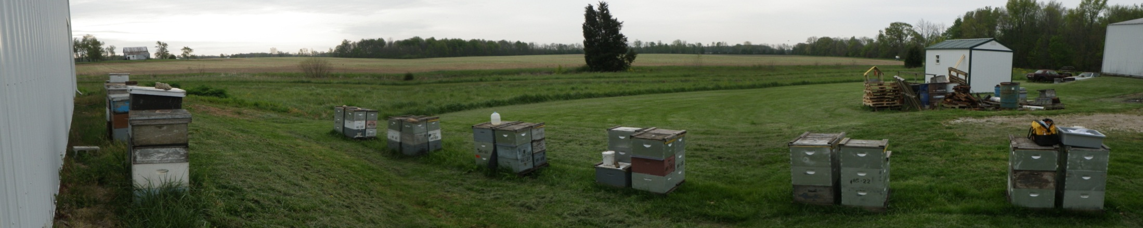
Sentinel Hives Programs
Retrospective investigations have limitations
Sentinel hives programs established in Indiana, Utah and Ontario in 2013:
      Actively monitor strength and health of selected stationary hives
      Assess intra-hive mortality with dead bee traps
      Monitor varroa mite, tracheal mite, and Nosema, etc.
      Record landscape data surrounding the colonies
      Analyze for neonicotinoids and other pesticide residues
Slide 61

Slide 63
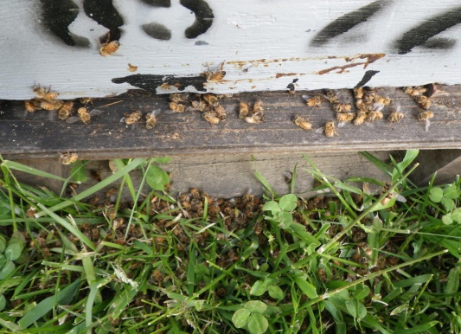



Bee Health Investigations in USA
  Better understand potential product related issues and contributing factors
  Encouraging beekeepers to contact us
  Investigation team consisting of over 30 trained individuals
  Bee experts, technical field experts, analytical experts
  Standardized protocols and SOP’s for conducting investigations
  Rapid response capability and in-house analytical
  Intent is to supplement official investigations by focusing on sites that will help address mitigation/stewardship needs if warranted
Hives
Fields
Planting
Surroundings
Slide 62

Slide 64

Wrap-up

Slide 65
Honey Bee Health Reality
Honey bees won't be going extinct any time soon, but commercial apiculture is at risk
Without commercial apiculture, contract pollination services will not be available, and certain foods will be more expensive and less readily available.
Without crop protection, we will not be able to produce enough quality food efficiently enough to feed the world’s population of an estimated 10 billion by 2050.
Apiculture and other forms of agriculture must coexist

Slide 66


Monitoring
Early Detection
Saves Hives

Slide 67

Apiculture Needs YOU!
Notes:
All stakeholders must understand that apiculture is agriculture too, where large numbers of animals are managed for products and services. Commercial apiculture is vital for crop pollination, but so to are pest management, crop management and business management all vital to the production of abundance, affordable and safe food that is needed to feed the growing world population.

Slide 68


Thank You!
dick.rogers@bayer.com

Slide 69
Blue Slide 1

Slide 70
Colony Collapse Disorder (CCD):
What it is, and what it isn’t

Slide 71
CCD: What it is (definition)
Phrase was coined in early 2007 to denote a specific set of symptoms observed in 2006
Symptoms
Rapid loss of adult bees
A queen and “handful” of bees present
No dead bees outside hive
Still some brood present
Slow or no invasion of secondary pests (e.g. SHB, wax moth)
f) Occurs during active beekeeping season (winter loss is not considered a symptom of CCD)
Page 70

Slide 72

Is this CCD?
Handful of bees
Queen
No dead bees outside hive
Nova Scotia Institute of Science
Halifax, NS, 6 April 2009
♥ 2009 REL Rogers, Wildwood Labs Inc.

Slide 73
CCD in Perspective
  Specific set of symptoms
  Symptoms occur in only a small percent of colony loss cases
  No single causative agent identified
  Adequate monitoring could identify the combination of causes in many cases
  Incidence is largely self-reported
Page 72

Slide 74

CCD in Perspective
  From a national survey* US beekeepers attributed their Top 5 losses to:
    Weak colonies in the fall 34%
    Queen failure 32%
    Starvation 31%
    Varroa mites 17%
    Poor wintering conditions 10%
Page 73

Slide 75
CCD: What it isn’t
It is not caused by a mysterious agent
It is not responsible for the global bee health situation
It is not common in occurrence; Seldom are all symptoms present together
It is not easily diagnosed; Surveys report that few beekeepers and others know the full definition of CCD
It is not even an it, THE CONDITION IS SIMPLY A SPECIFIC SET OF SYMPTOMS CAUSED BY A COMPLEX SET OF FACTORS
Page 74

